Slide 1





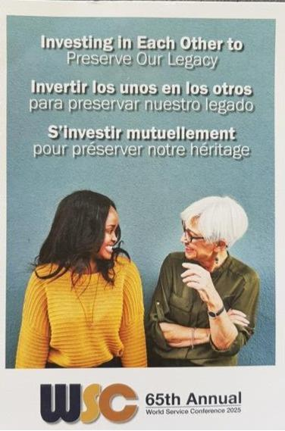


WSC 2025 DELEGATE’S REPORT
By Cheryl Sorenson - P63 Idaho
“Investing In Each Other to Preserve Our Legacy”

Slide 2
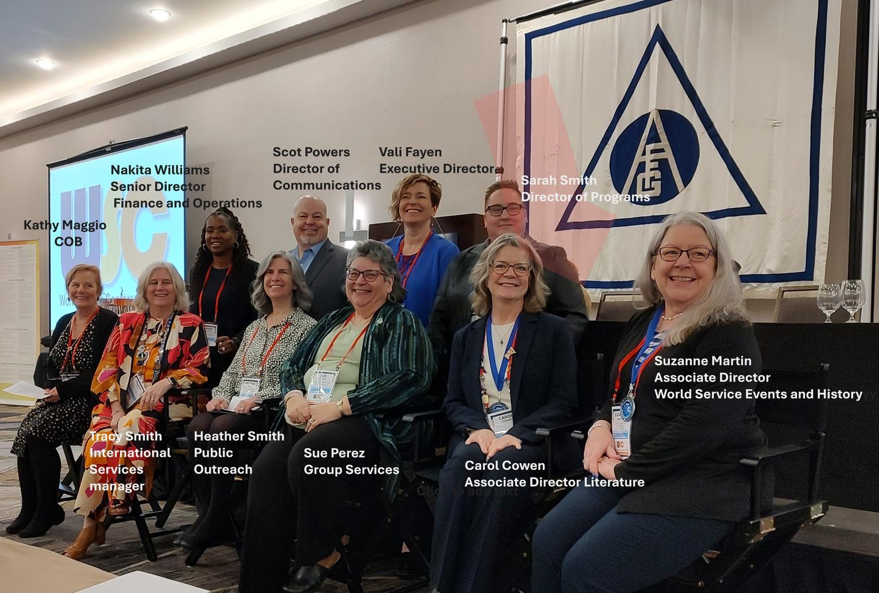
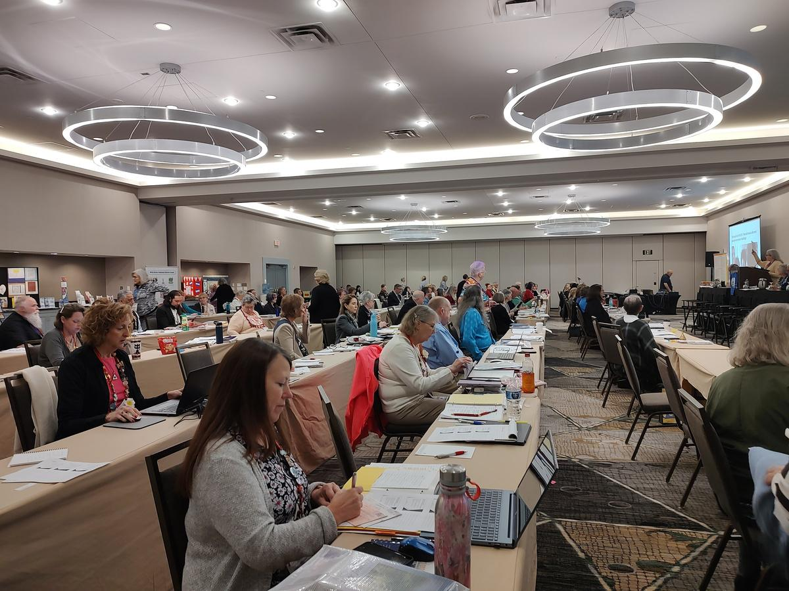
WSO Staff
Conference Center

Slide 3
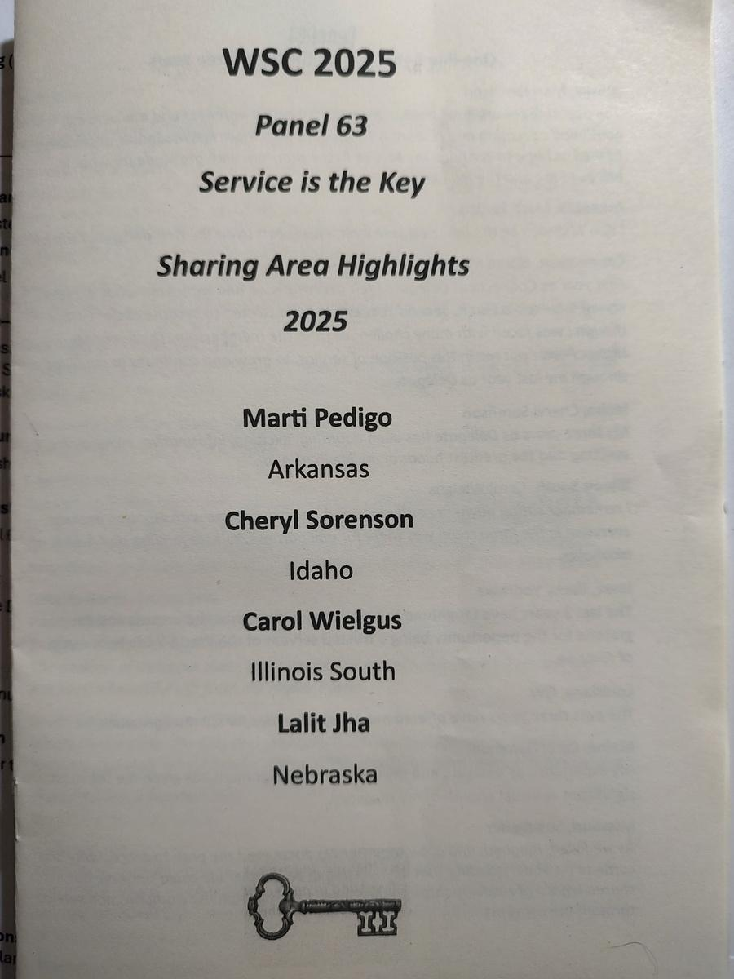
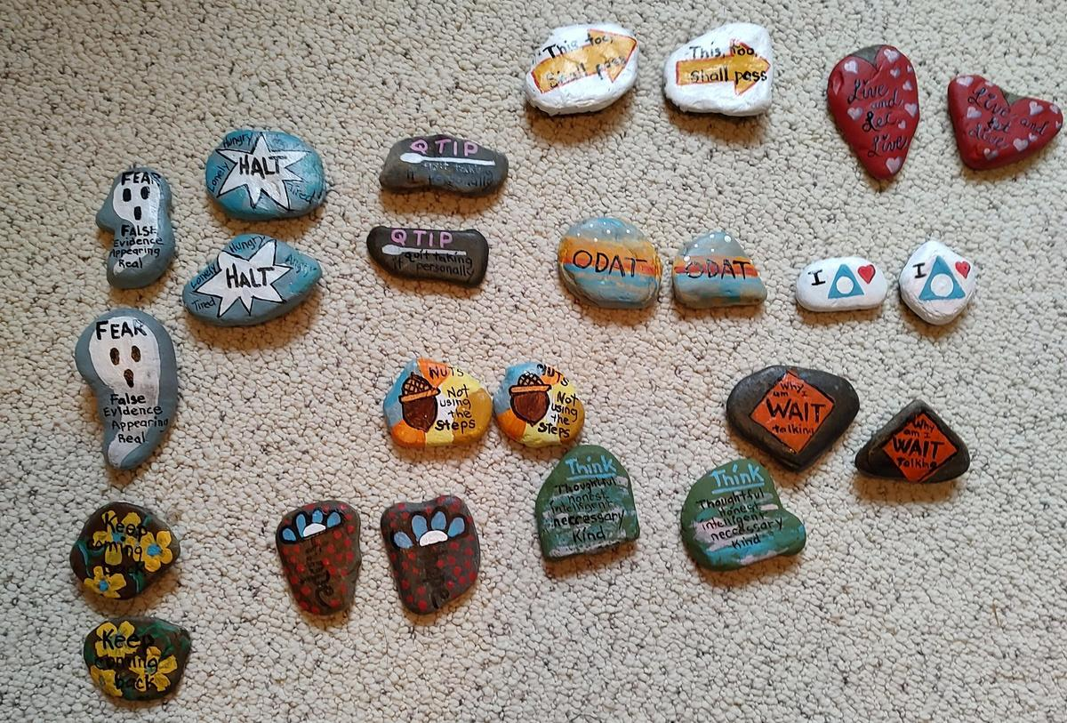
Ice breaker
Sharing Highlights
P65 - Biggest fear for the next 3 years
P64 - What is it like in the “Sweet Spot”
P63 - Reflection on the last 3 years

Slide 4
Background
Terminology:
WSO vs AFG
The Charter is to be the guardian of both Al-Anon’s world services and it’s Twelve Traditions. It’s a service body not a government and guides the AFG.
The Bylaws are what the WSO uses to define their legally binding rules.
Who votes at the WSC?
The Delegates
Who makes up the conference?
⅔ of the conference are Delegates, ⅓ staff and volunteers

Slide 5

Delegates voted on:
  Seating Motion of trustees
  Changes to the local service section of the policy digest (in svc manual)
  2024 Audit report
  Seating motion of future non-voting WSC participants
  2025 Finance Committee report
  2024 Annual report
  Suspension of implementation of the Choosing a Group Name Policy
( all passed)

Slide 6
Concept 6
“The conference acknowledges the primary
administrative responsibility of the Trustees”
In 1984 the conference voted that the concepts, which were developed in
1968, are to be accorded the same stature as the steps and traditions.
They are part of our legacies
The concepts record the “why” of our service structure
and
the key principles of Concept 6 are:
trust, authority, freedom, equality,
participation, respect, goodwill,
listening and open-mindedness

Slide 7

Trustee Nominations
Duties
Trustees are the guarantors of prudent management of the World Service Office and the Canadian Service Office
Trustees have authority under law to manage the business of Al‑Anon Family Group Headquarters, Inc. and Al‑Anon Family Group Headquarters (Canada) Inc.
Trustees hire the Executive Director and Director of Finance & Operations
Trustees are voting members of WSC and serve on or chair WSO Committees
Trustees serve as the guardians of Al‑Anon’s Twelve Traditions, its Twelve Concepts of Service, and the “Al‑Anon World Service Conference Charter”
Role Description
Responsible for all Al‑Anon’s service activities, as well as for Al‑Anon’s worldwide public relations. Expected to spearhead the formulation of Al‑Anon policy and its proper execution. Active guardians of Al‑Anon’s Twelve Traditions. Has ultimate responsibility for the preservation and prudent management of all Al‑Anon Family Group Headquarters, Inc. (AFG, Inc.) financial assets. – Concept Six (2022‑2025 Al‑Anon/Alateen Service Manual [P‑24/27])
Qualifications
Must be an active member of Al‑Anon and have service experience beyond the
group level such as a District Representative, Area Delegate, Assembly Officer or Coordinator, or AIS Liaison to the AWSC
Must have ten years of continuous Al‑Anon and/or Alateen membership (Alateen membership does count!)
Must relinquish all Al‑Anon service positions beyond the group level during term of service
Must possess an understanding of the Twelve Traditions and the Twelve Concepts of Service
Must possess a broad view of the policies of Al‑Anon Family Groups
Cannot be an Al‑Anon member who has ever been a member of A.A.
Delegates must wait two full years after their term ends in December before applying. This ensures Delegates on Committees on Trustees reviewing applications have not served at Conference with applicants.
Must be eligible to become an Al‑Anon Member Involved in Alateen Service (AMIAS)
Regional Trustees must reside within the Region from which they are nominated and be selected by their Area process

Slide 8
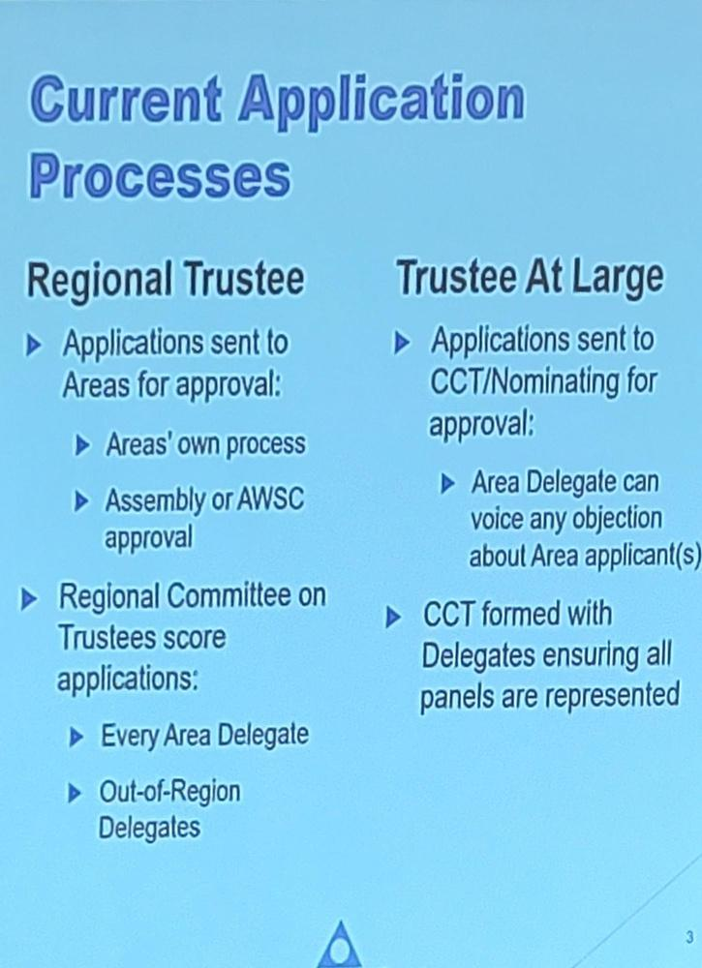
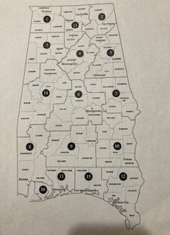
trustee nominations cont:
Election Process for Trustees
Proposed Application
Process
*Conference committee will incorporate
Regional perspectives and work together
*Areas will need to develop a vetting system to nominate candidates if not already in place
*All nominations will go through CCT (WSO) only-no regional committees
*CLT in 2026 will revisit options
ALNWFL currently has
no regional trustee

Slide 9
Question #1
What document governs the AFG?
What document governs the WSO?
(both must be correct)

Slide 10
AFG is governed by the Charter
WSO is governed by the Bylaws

Slide 11

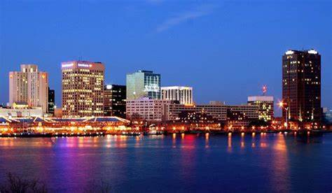
Beginning 2026:
*3 Delegates from each panel will be on the CLT
*WSC is returning to a 5 day conference
Next year in Newport News, Virginia
*3 Delegates, one from each panel,
will be chosen to participate on the
Conference Leadership team (CLT)
with voice but no vote
2026 is the 75 year anniversary of AFG

Slide 12
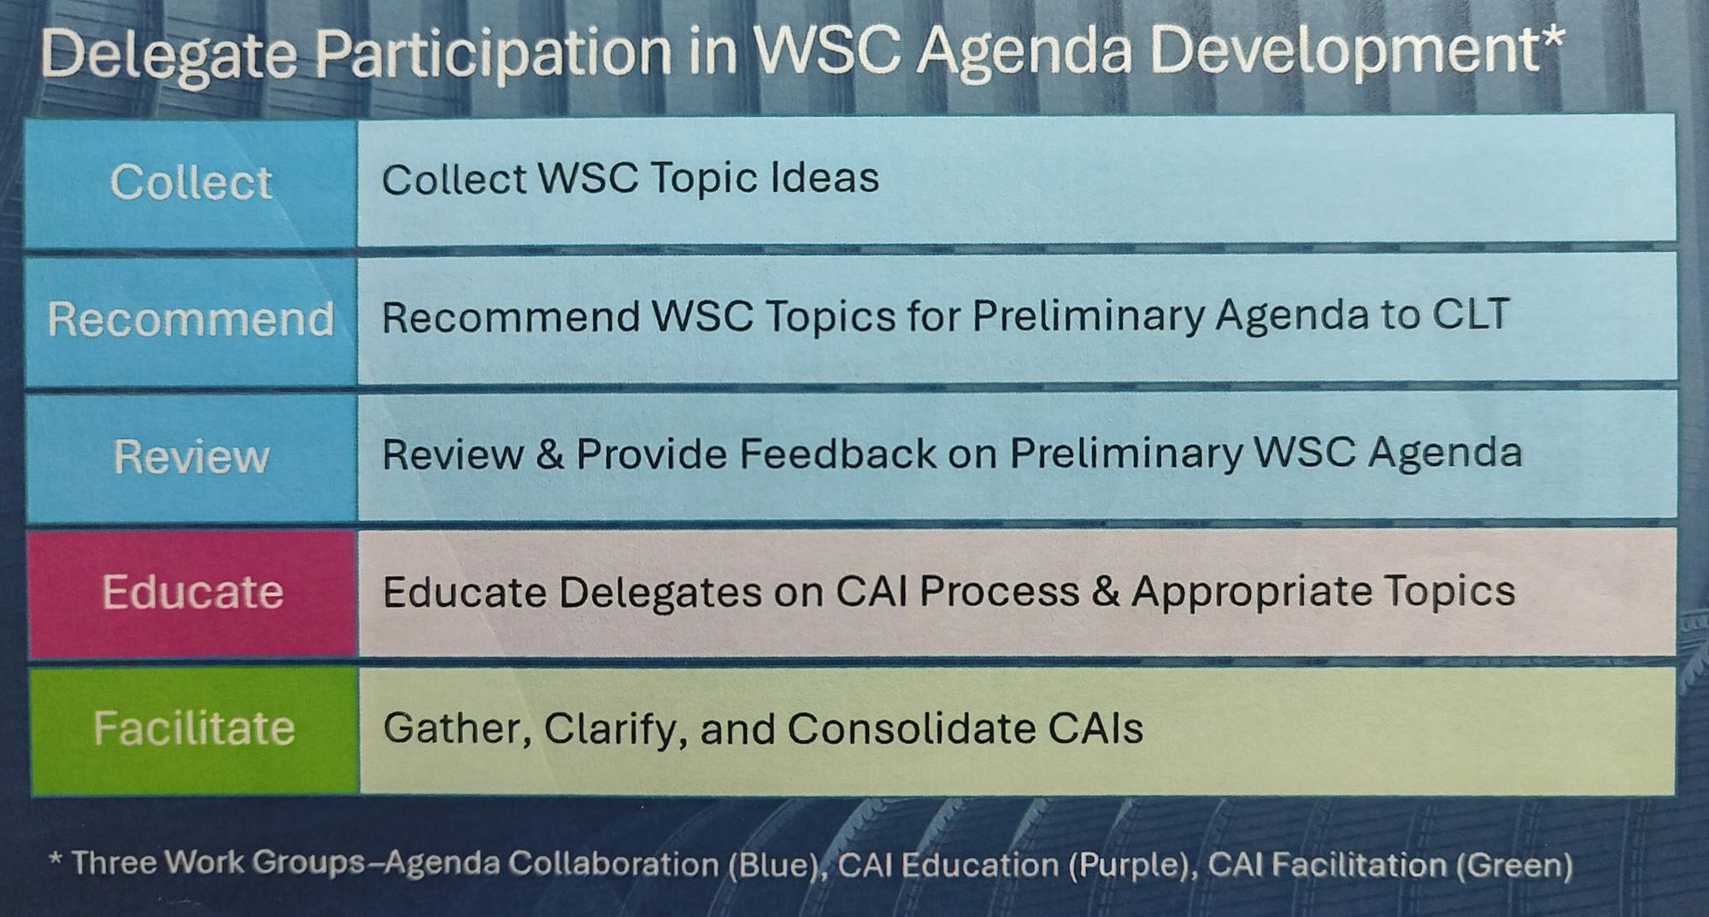
Delegate participation on the CLT
(Conference Leadership Team)

Slide 13
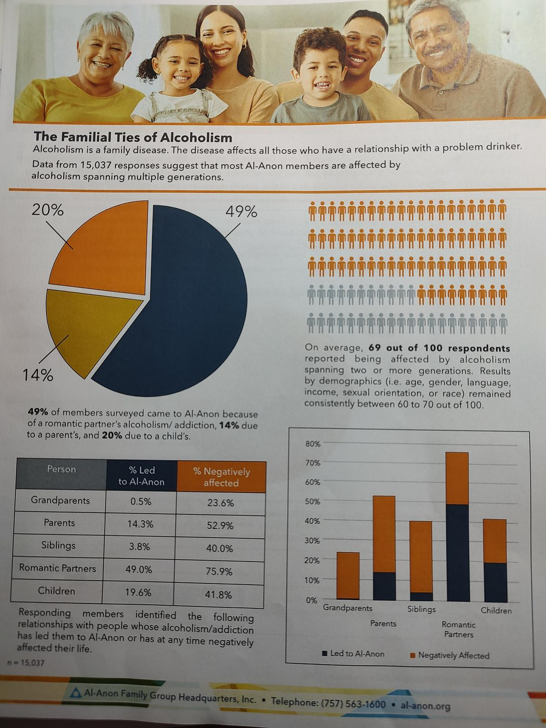
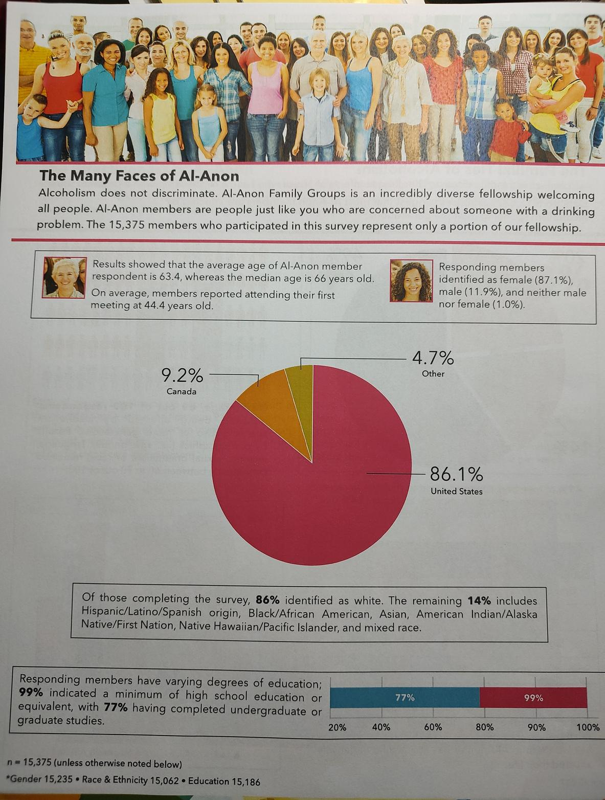
Membership Survey
15,037 responses
from
21,000 Al-Anon groups
in
118 countries

Slide 14

Choosing a Group Name
Choosing a group name
Women who run With Wolves
In 2024: (Svc Manual pg. 28)
The name of a group is a reflection of Step Twelve. Some names could confuse members and prevent them from attending the meeting. The WSO will register names that designate them for being with gender identifying orientations with the understanding that in keeping with Tradition Three and Tradition Five the groups will welcome anyone

Slide 15

Chosing a group name cont:
2024 WSC:
The policy committee directed staff to communicate widely through the links of service that existing groups with name containing such designations that were not “all inclusive” would be encouraged to practice “obedience to the unenforceable” by aligning their group name with the new policy.
2025 WSC:
The Policy Committee acknowledges that this could have been made clearer and that groups were not offered the opportunity to weigh in.
We made a mistake by not having the foresight to recognize that possibility and we regret the harm that oversight caused

Slide 16
choosing a group
name cont:
Arguments by Delegates
*Disallowing identifiers will reduce membership
*The problem lies not with naming the groups,
but in the members
of the groups not welcoming all
*There is a difference between identifiers and affiliations
What’s next?
WSO won’t enforce a group name
WSO won’t close a group for that reason
WSO will only ask NEW groups registering to comply
This will be an ongoing discussion for WSC 2026

Slide 17
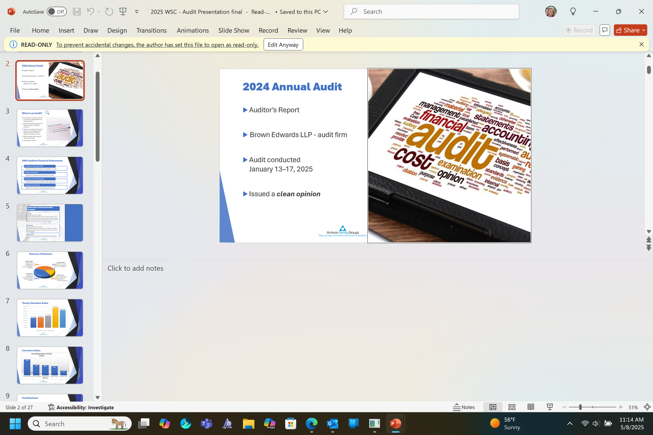
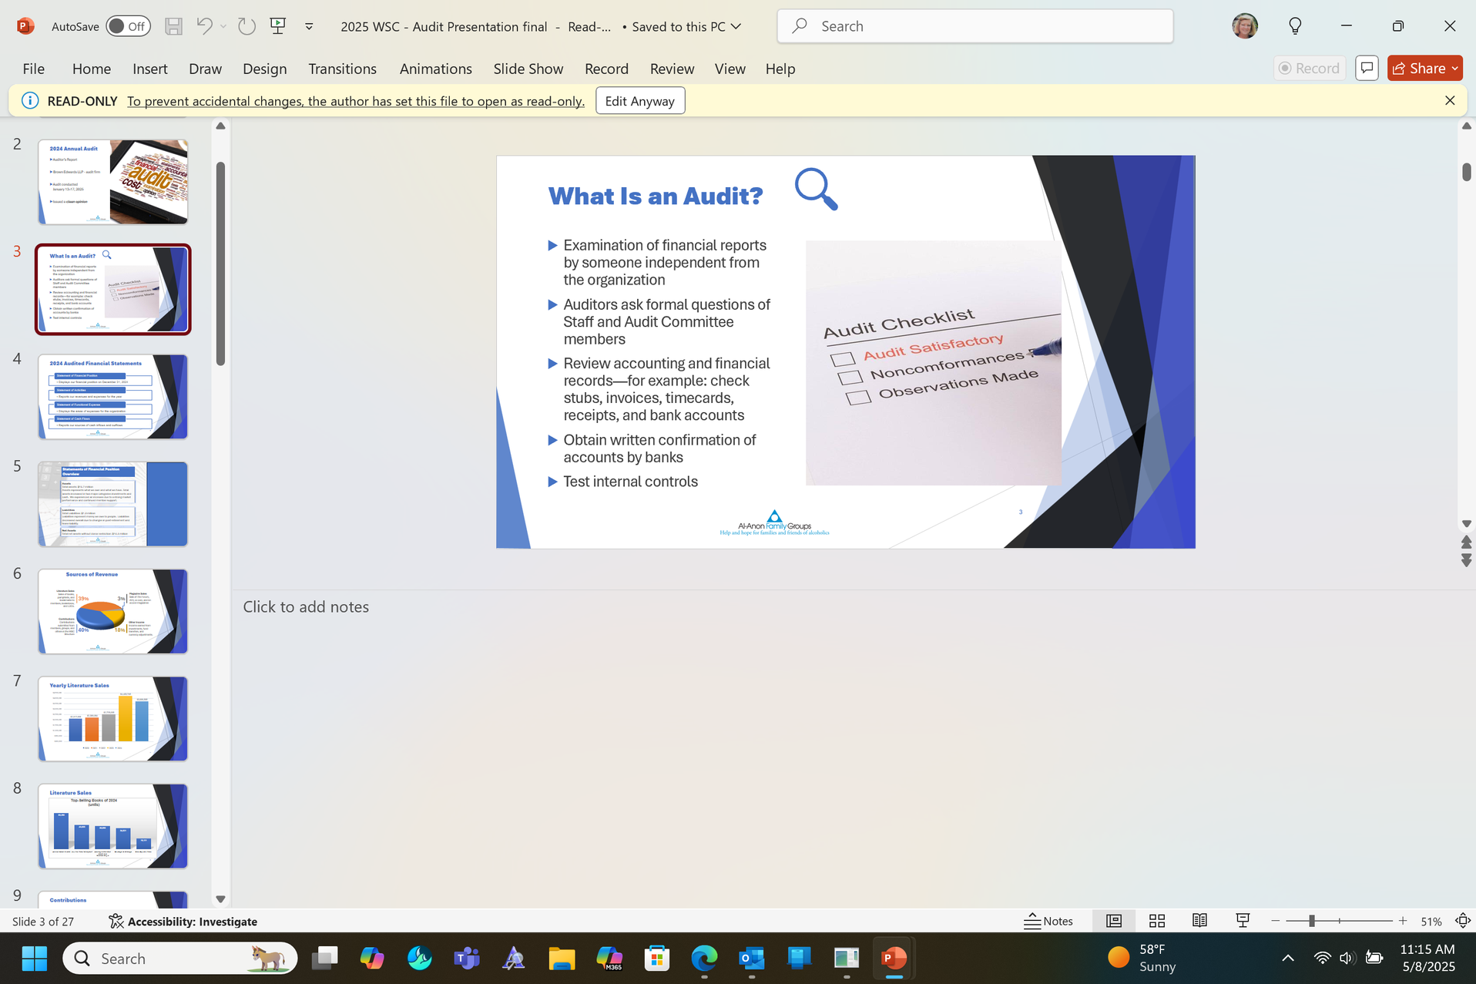
2024 Audit and Financials

Slide 18
audit cont:
2024 Audit Report highlights
By: BrownEdwards
On December 31, 2024 Al-Anon Family Group Headquarters, Inc (AFG) had total assets of $15,776,137 and liabilities of $1,353,640, leaving net assets of $14,442497 among the three funds of General, Reserve, and Building
2024 Revenue total was $6,796,472 in the General fund
2024 Expenses were $6,334,828
as a result, the General Fund’s net assets increase by $461,644
Because of this increase, $169,200 was transferred back to the Reserve Fund
Literature sales yielded a gross profit of $2,929,412
Because of improved market performance in 2024, a net increase of $851,424 was recorded in the Reserve Fund assets

Slide 19

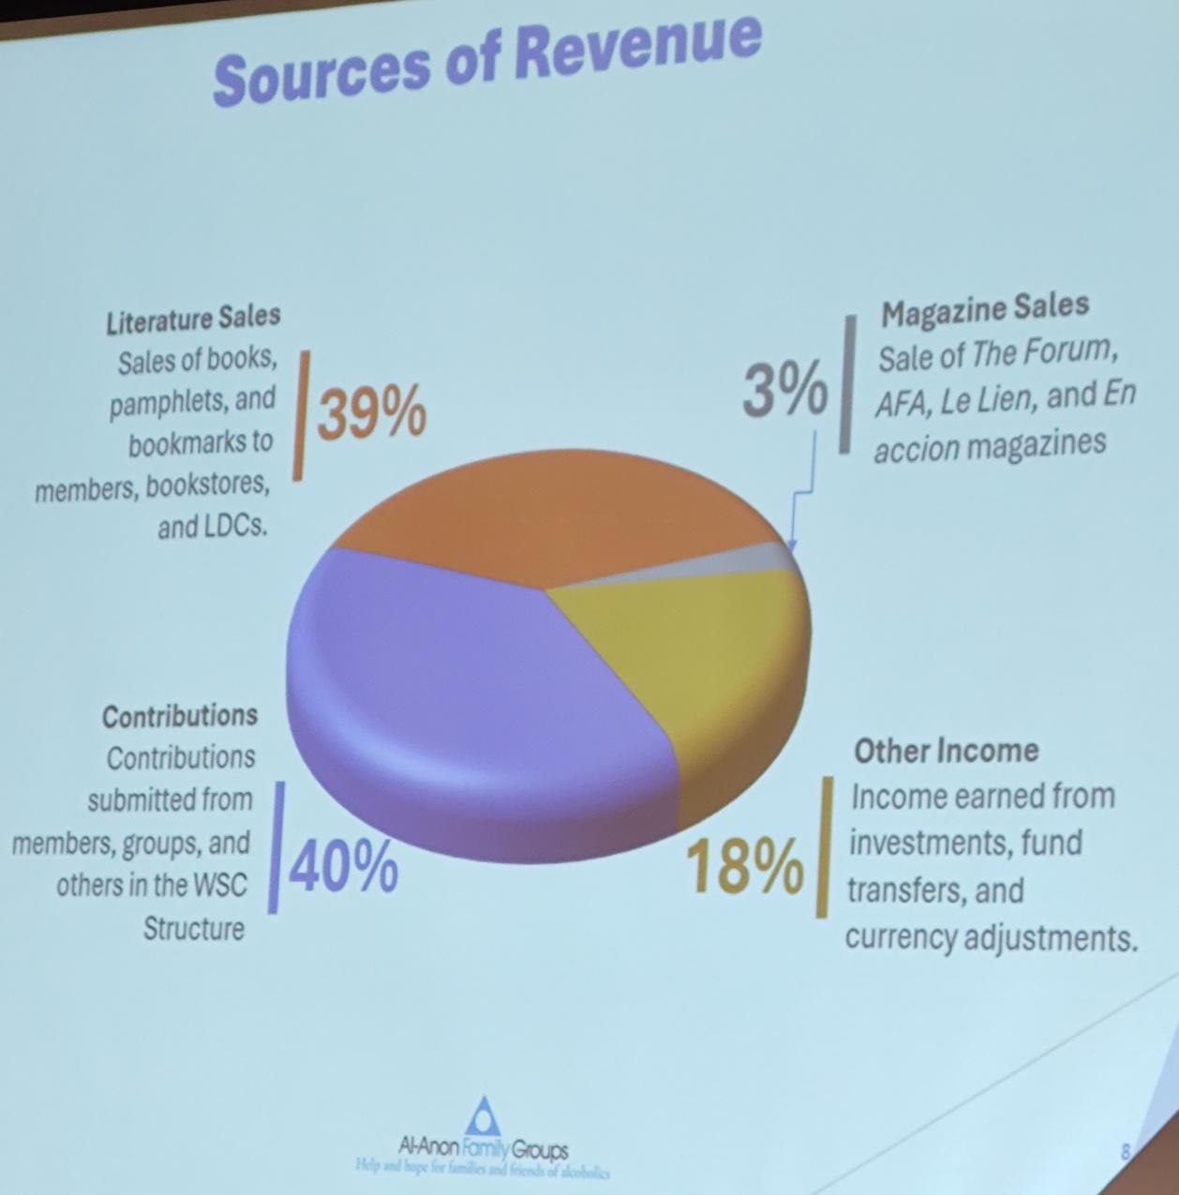

Audit Conclusions:
Assets
$15.7 million
Liabilities
$1.3 million
Net Assets
$14.4 million
Contributions remain steady
Groups contributed the most: $1,257,400 or 42%
Individual contributions: $443,095 or 15%

Slide 20
2025 Budget
overview
New Projects:
PSAs on Podcasts
Ads in magazines
Exhibits
Linkedin add to educators
Budget is expected to be a slight decrease over 2024
Proposed expenses:
Higher Expenses are expected
7% over 2024
2025 AA Intl. Convention
Complete new Svc. Manual due out in 2026
New office equipment
New van
Upgrading core computer systems:
accounting online store
group records meeting searches
financial systems AFG Connects
(this is all funded from the reserve fund)
No new literature is planned for 2025 so literature sales are estimated to be 4% lower
Projecting a small increase
over 2024 ($135,970)

Slide 21
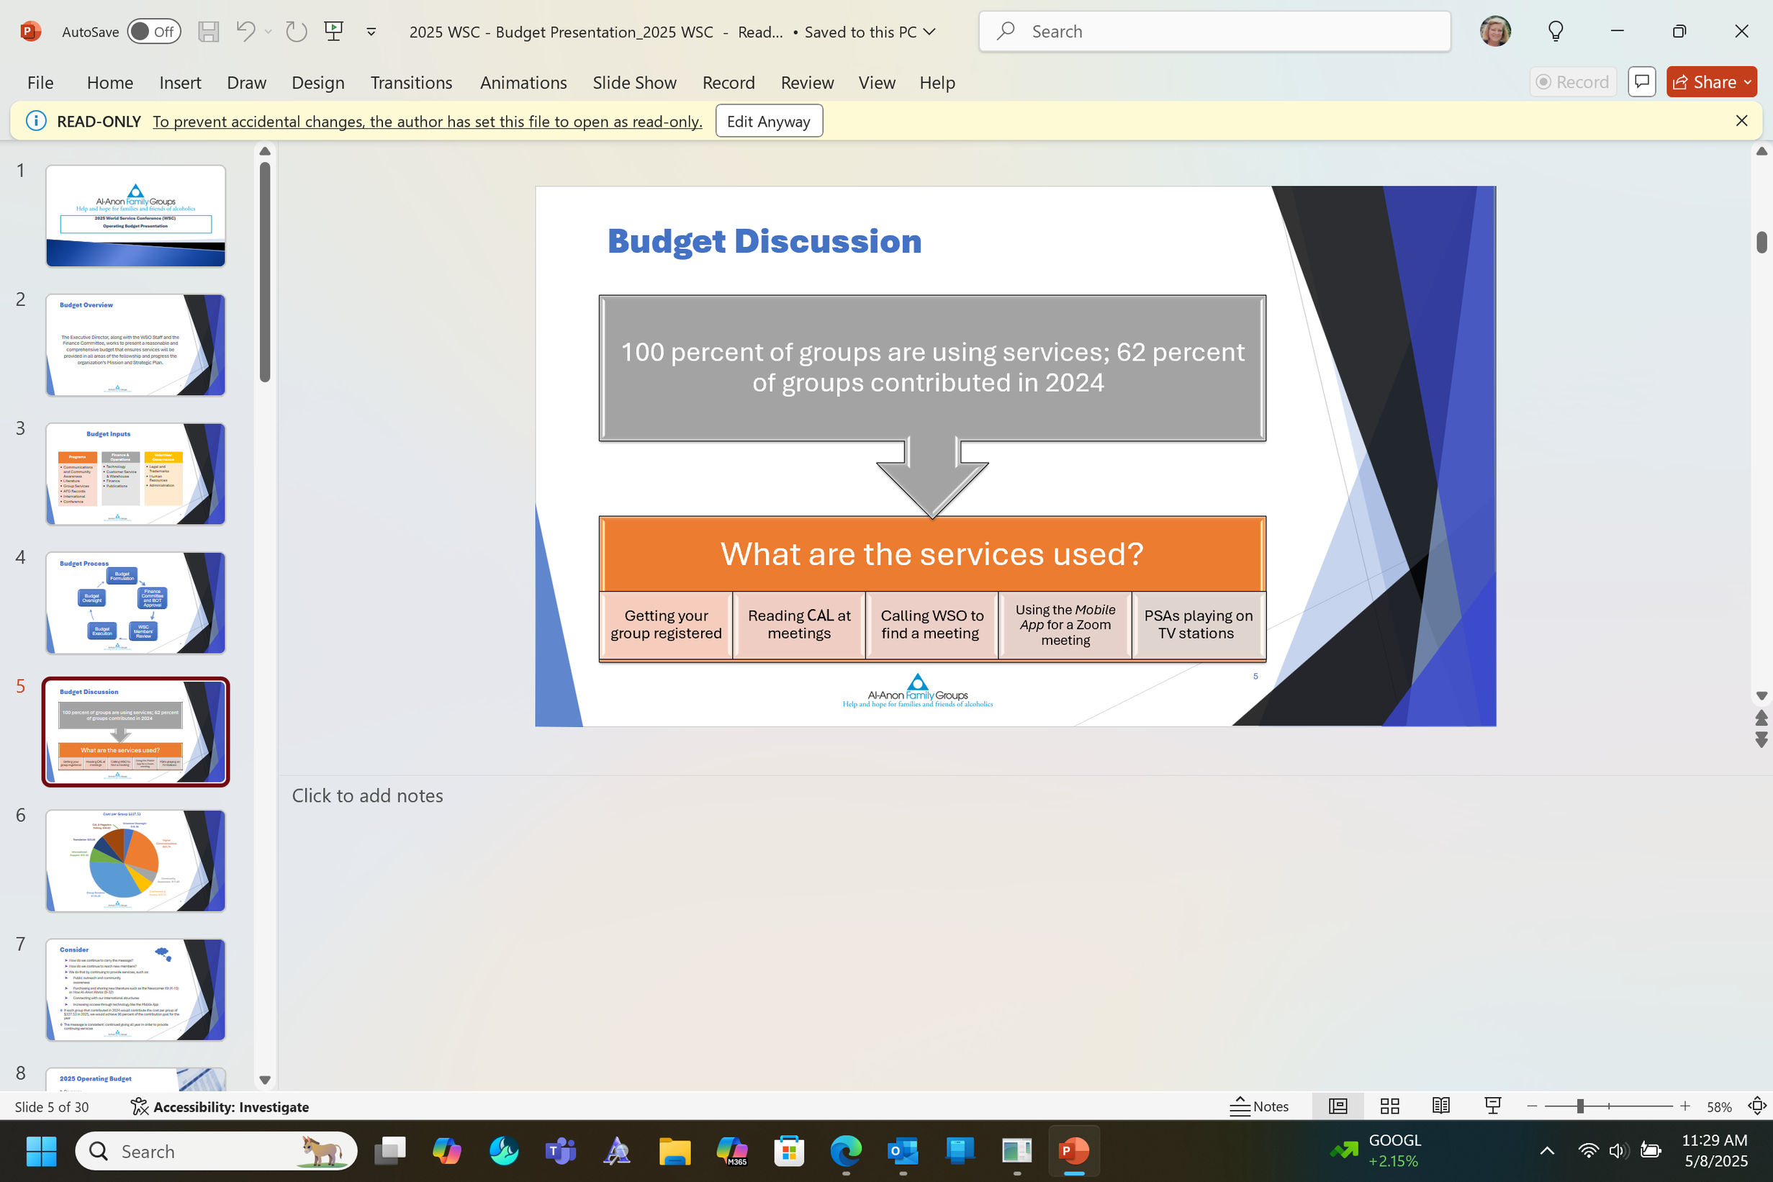
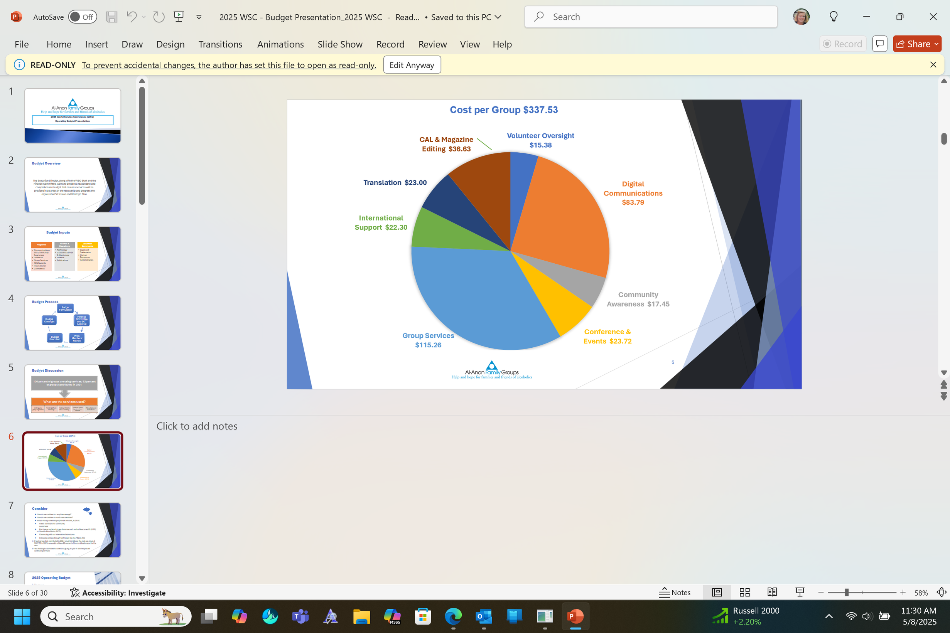
Budget Cont
interesting fact:
The quarterly appeal is to the member, not the group
if all groups contributed,
WSO would be able to reach 96% of their budgeted goal to operate
$6.49/week
$28.12/month
$337.53/year

Slide 22
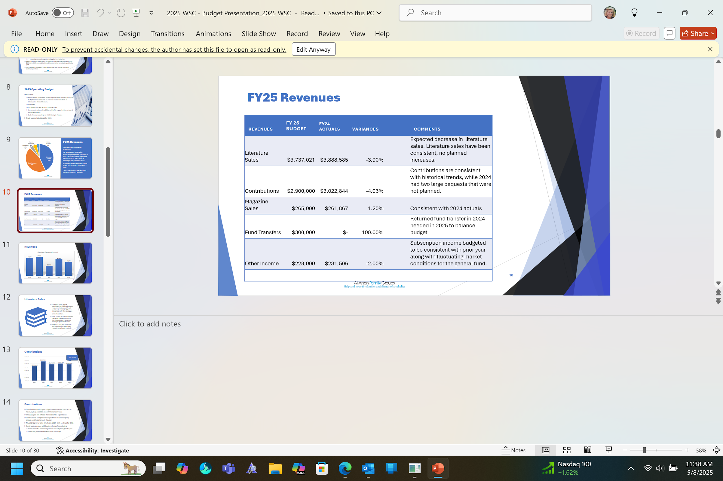
budget cont

Slide 23
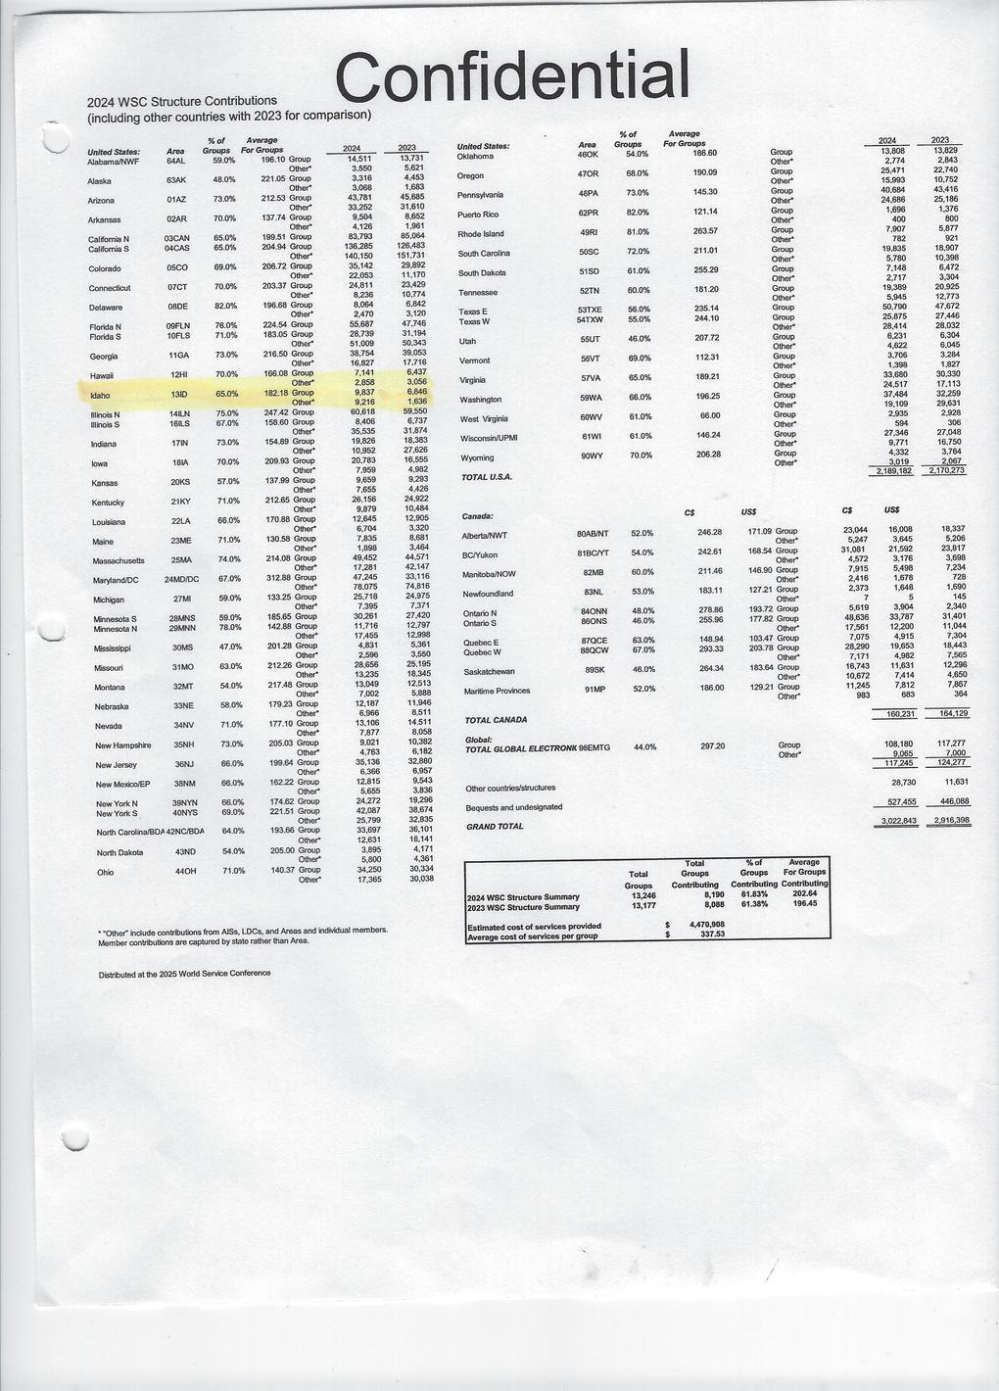
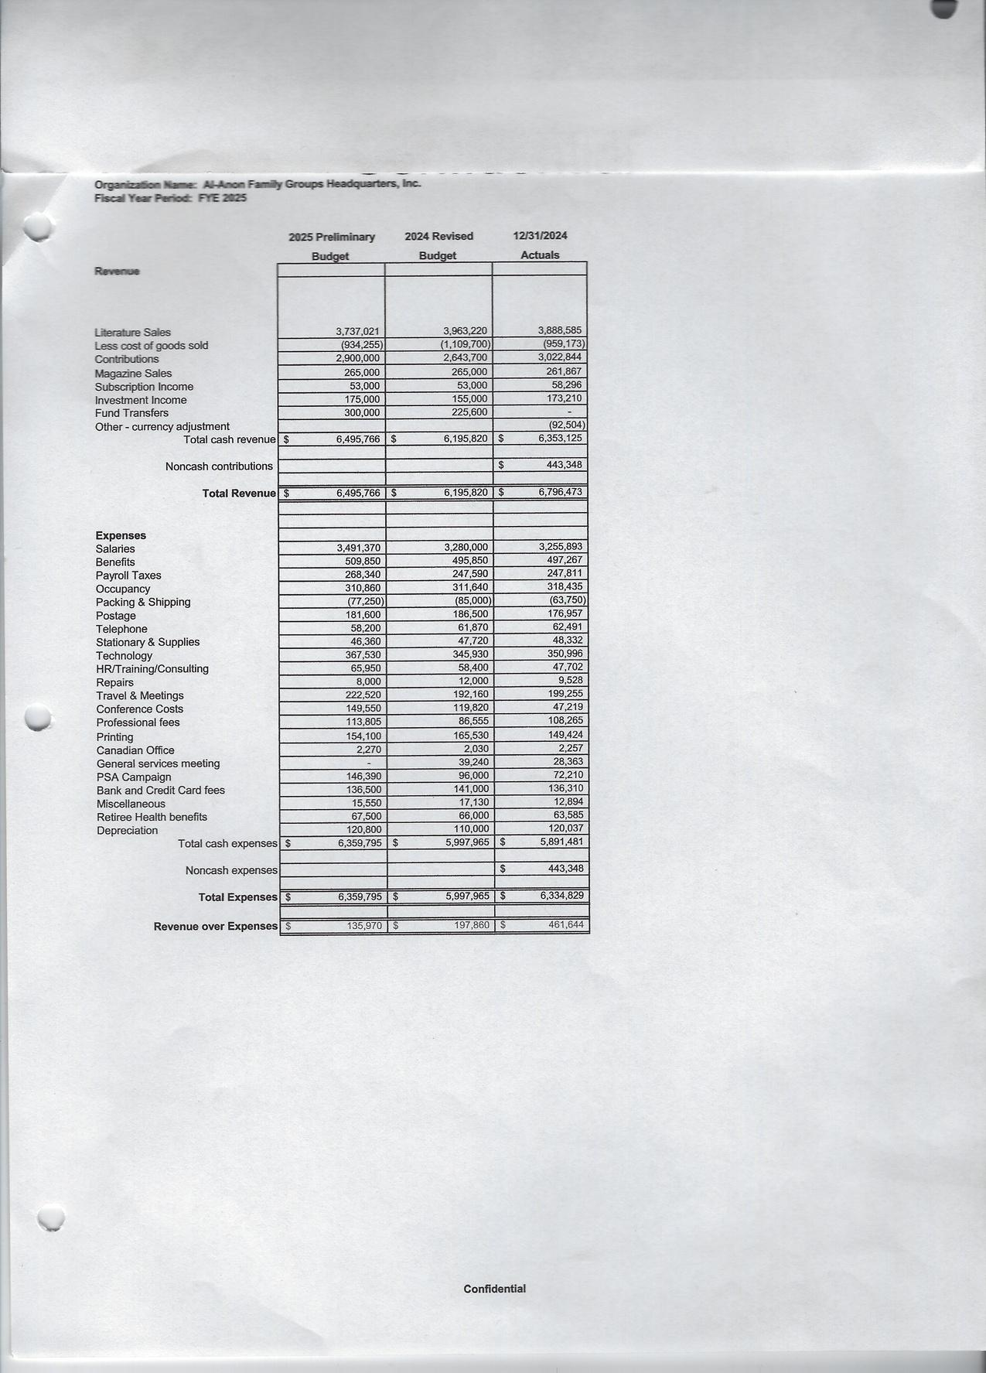
budget cont
BUDGET
FISCAL YEAR 2025
2024
Structure Contributions
Idaho: 65% of groups contributing
National average: 61.83%

Slide 24
In the group name:
Women who Run with wolves
which is an identifier and which is an affiliation?

Slide 25
Women is an identifier
ie: I am a woman so I want to go to a women’s meeting
Who run with wolves is an affiliation:
ie: I run with wolves so I want to go to this meeting
Identifiers are acceptable
affiliations are not acceptable

Slide 26

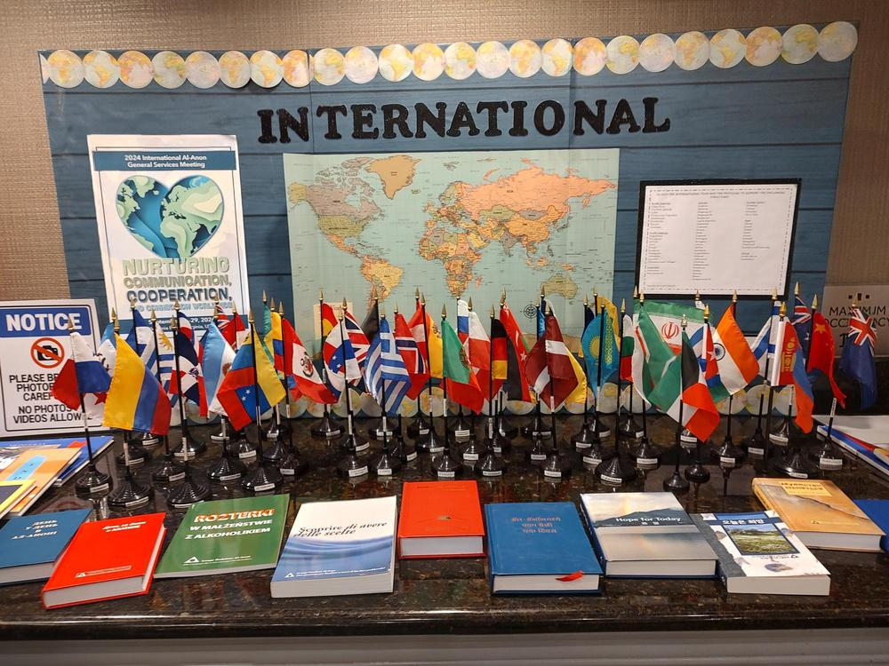
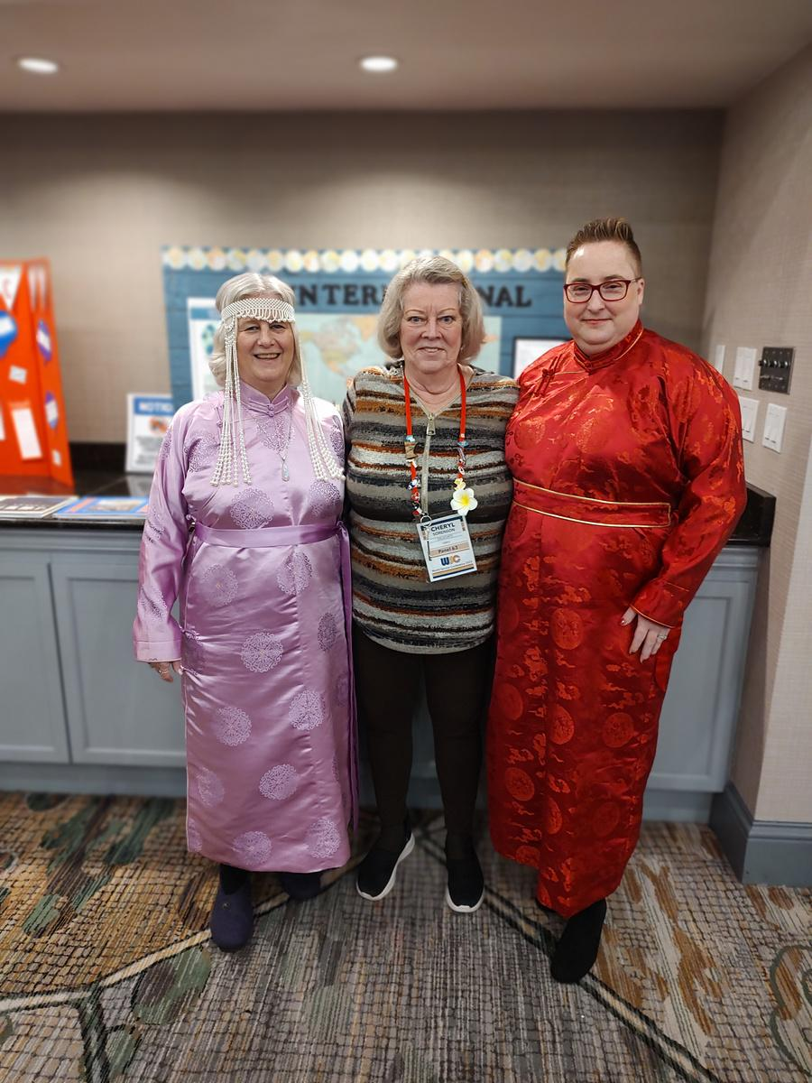
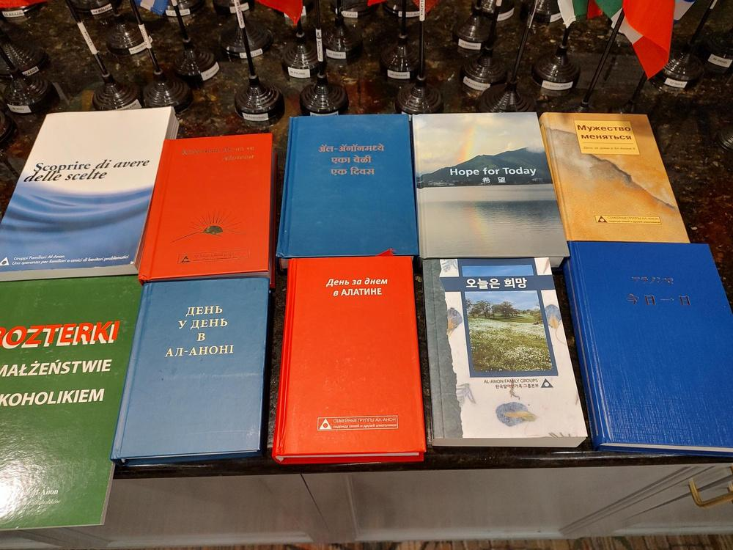
International Coordination Committee (ICC) Tracy Smith & Sarah Smith
Why go? In person visits are important
Where to go? By request and need
2024
in person:
Korea - 100+ attendees
Mongolia - 75+ attendees
virtual:
China 200+ attendees
India - 200+ attendees
22 new language requests for books

Slide 27


GROWING FUTURE VOLUNTEERS
How do we get more involved
What’s missing in our Area?
*Write guidelines for each service position
*hands on learning with a mentor/mentee
*build Area service structures
*involve younger members
*job descriptions
*Alateens
*Plant the “seed” early with workshops/seminars
*eliminate the fear of failure

Slide 28


ALATEEN
RECERTIFICATION
*6 AREAS have completed
(Idaho is one of them!)
*55 are in the process
*3 have not started

Slide 29

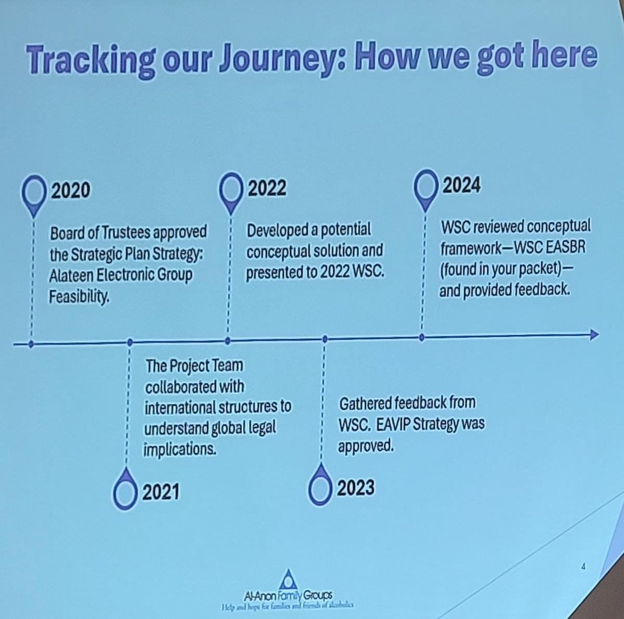
Electronic Alateen Validation
The objective is to make electronic groups
available for all Alateen members who wish
to participate, ensuring the safety of the
Alateen and AMIAS members

Slide 30
Electronic Alateen
Validation cont:
IF Idaho Area accepts Alateen Electronic (this must be decided by July 2026)
meetings into our service structure we must consider two parts:
Validation
We must show that we have adequately protected the Alateens and AMIAS
Implementation
We must develop a tracking system and update training
Alateen Participation Minimums
in person meetings
Electronic Alateen Group Minimums
13 years or older
participate in pre-interview with the group they want to attend
show proof of age
verified photo ID
Alateens participating in a hybrid meeting MUST reside in your Area
Same as US, in addition:
meetings cannot be recorded, two group sponsors must be present
AMIAS-E need to maintain a list of Alateens interviewed and admitted to that group
only group name, meeting day, time and group email can be displayed to public
If any Alateen wants to join an international E-meeting they must meet the hosting country’s requirements

Slide 31
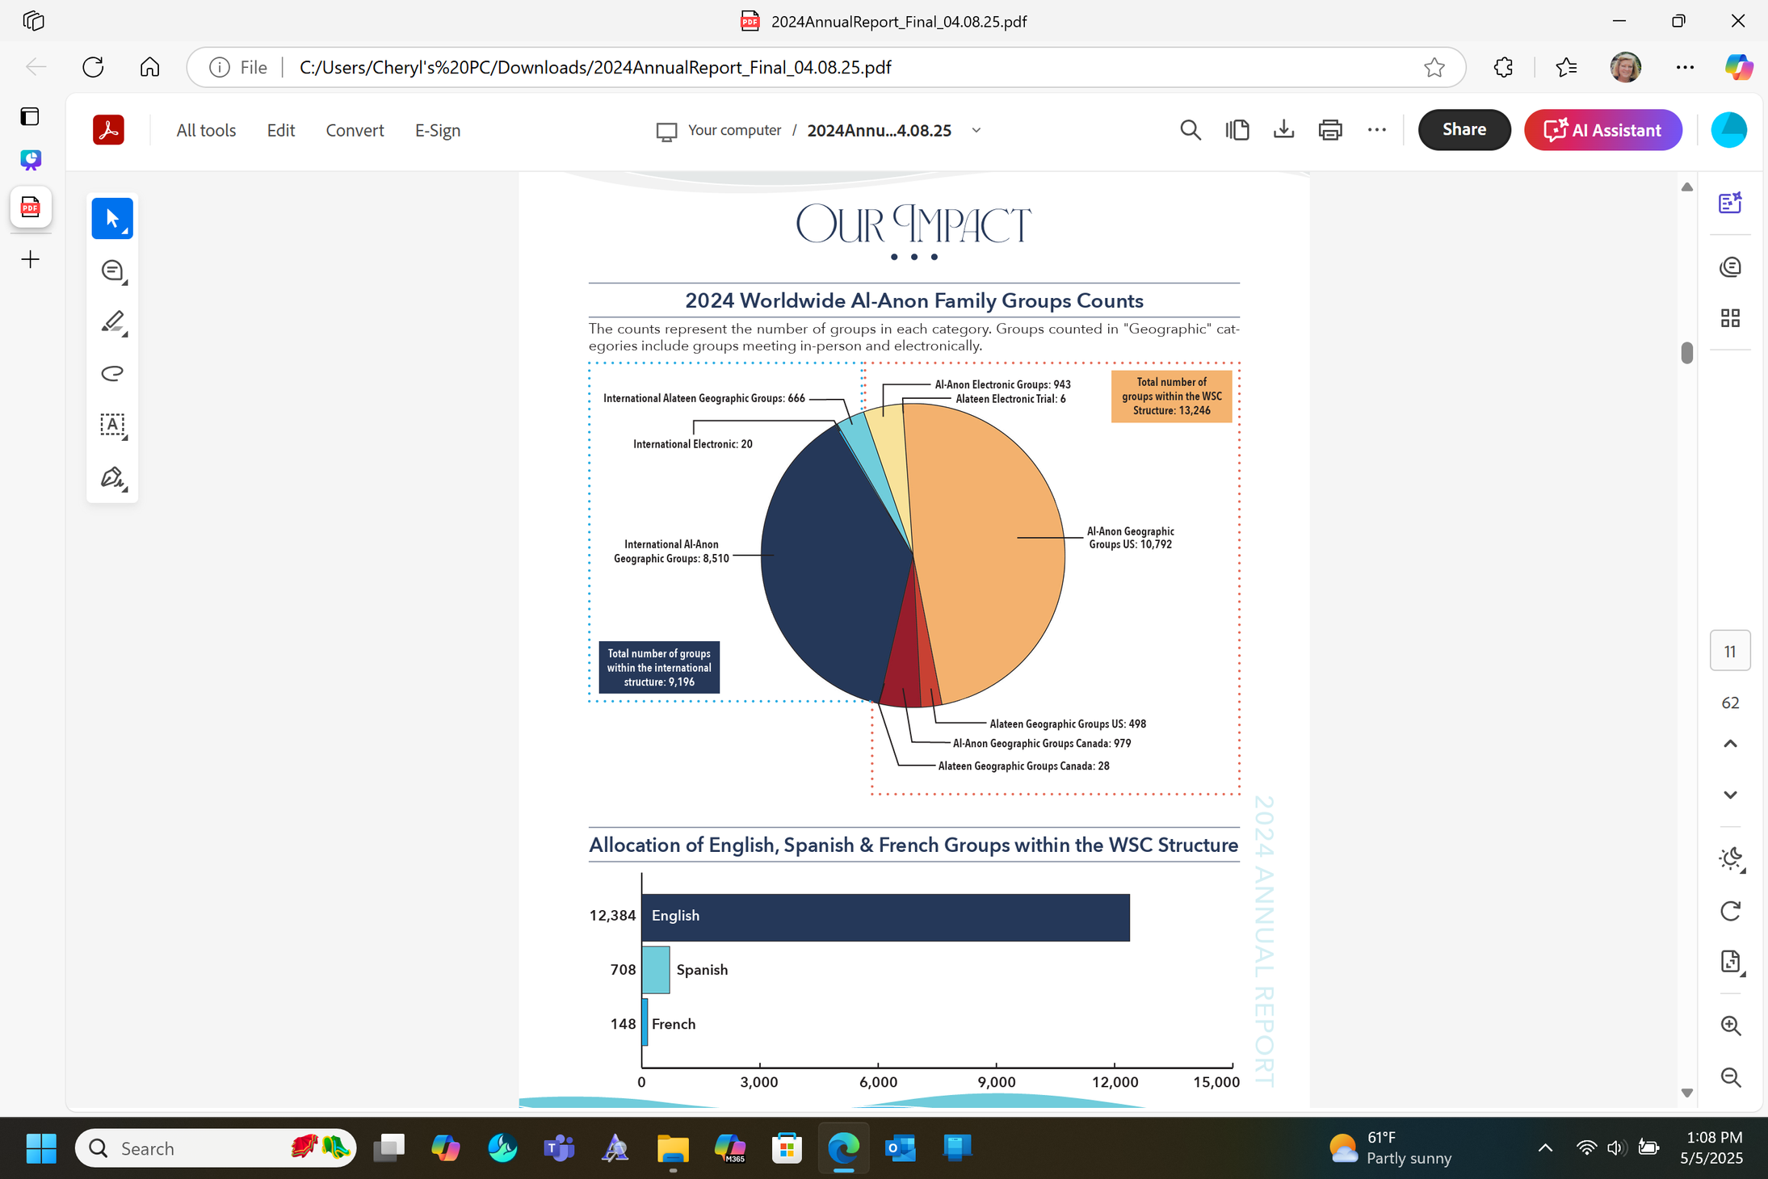
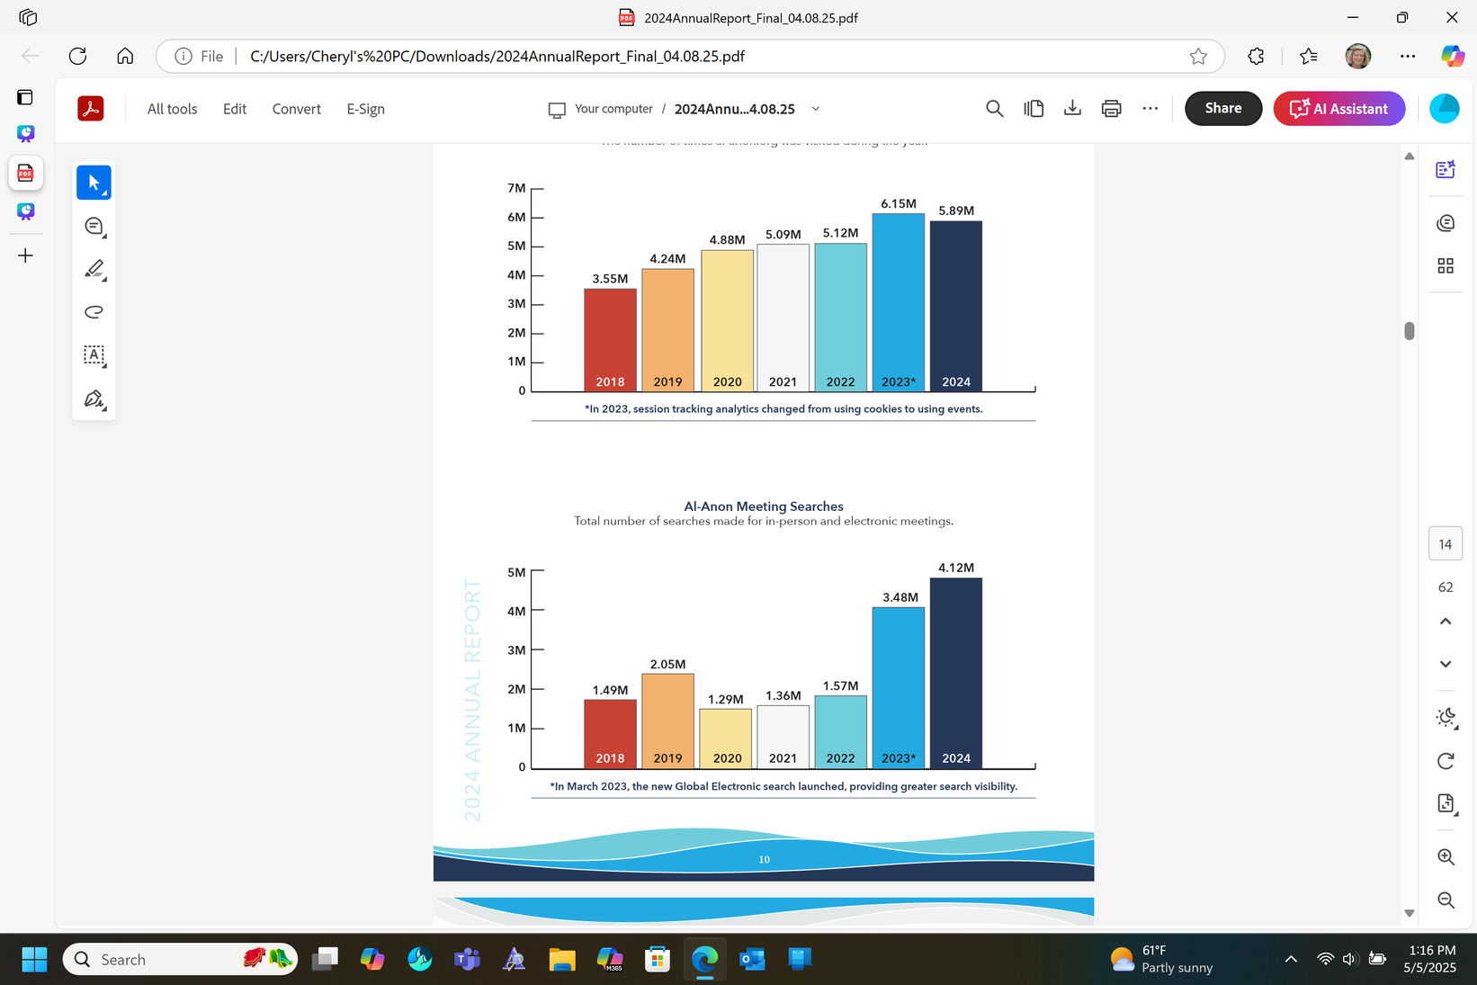
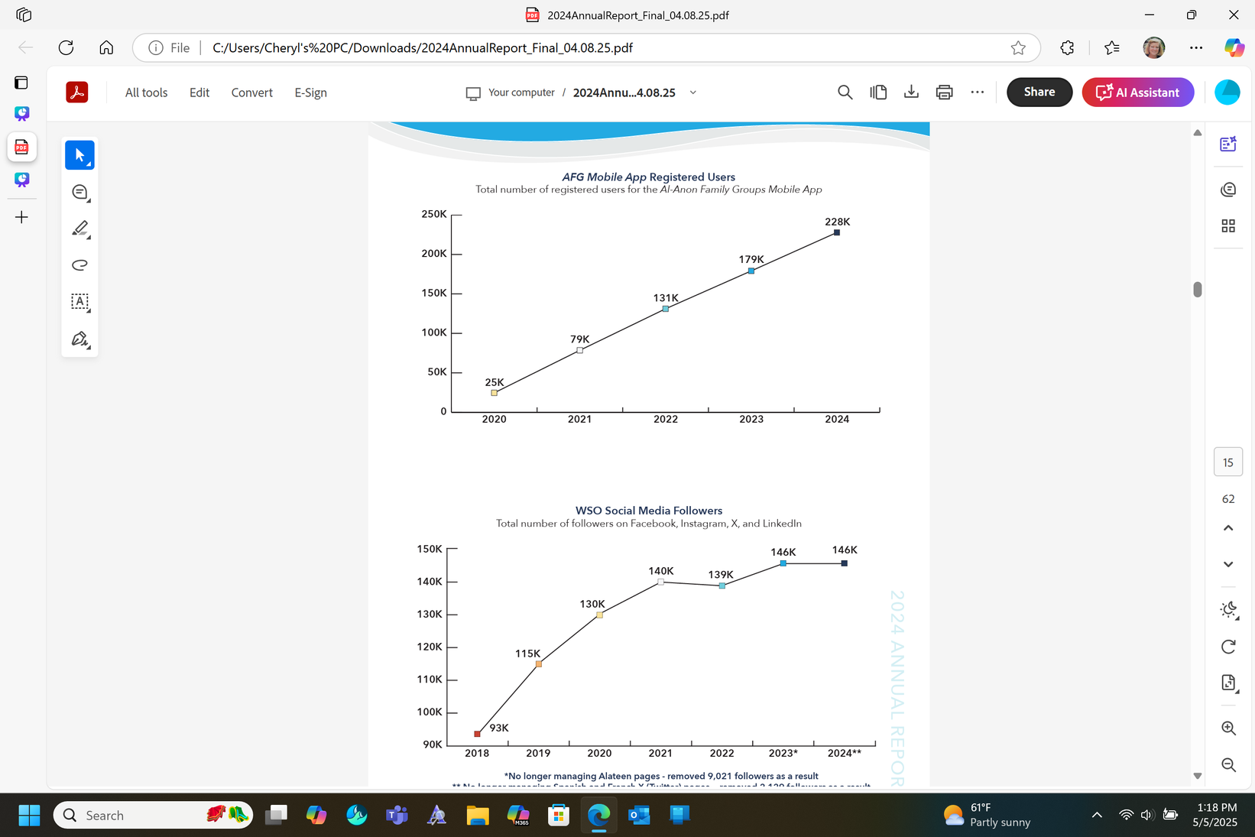
Annual Report

Slide 32
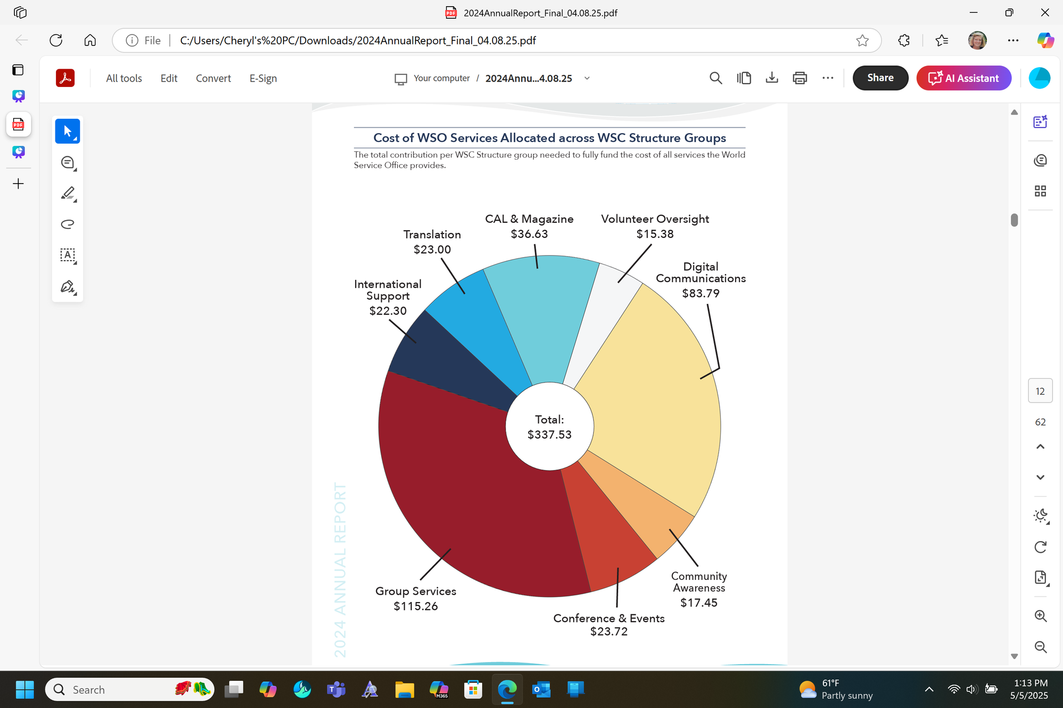
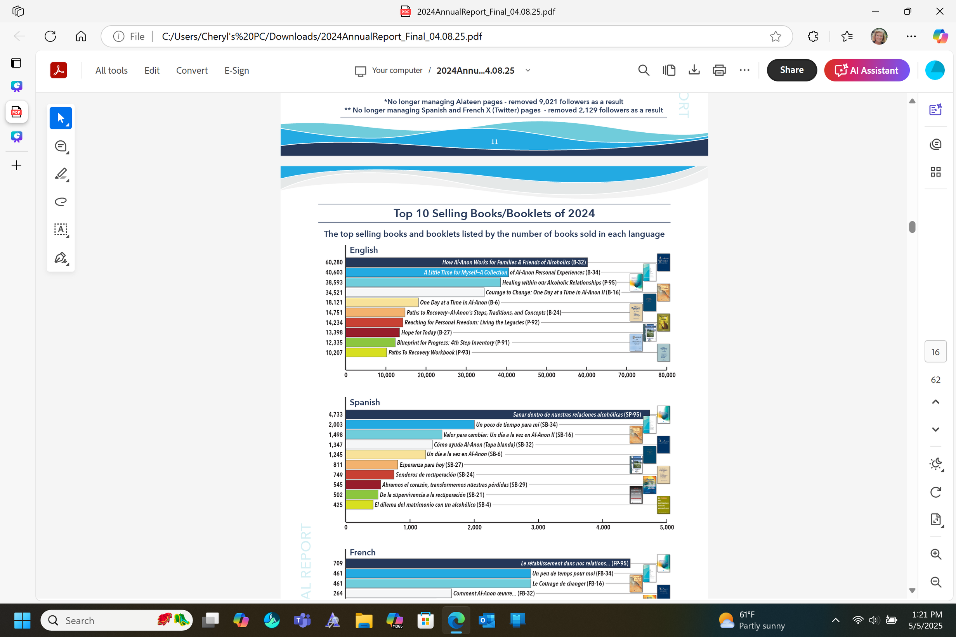
Annual Report cont:

Slide 33

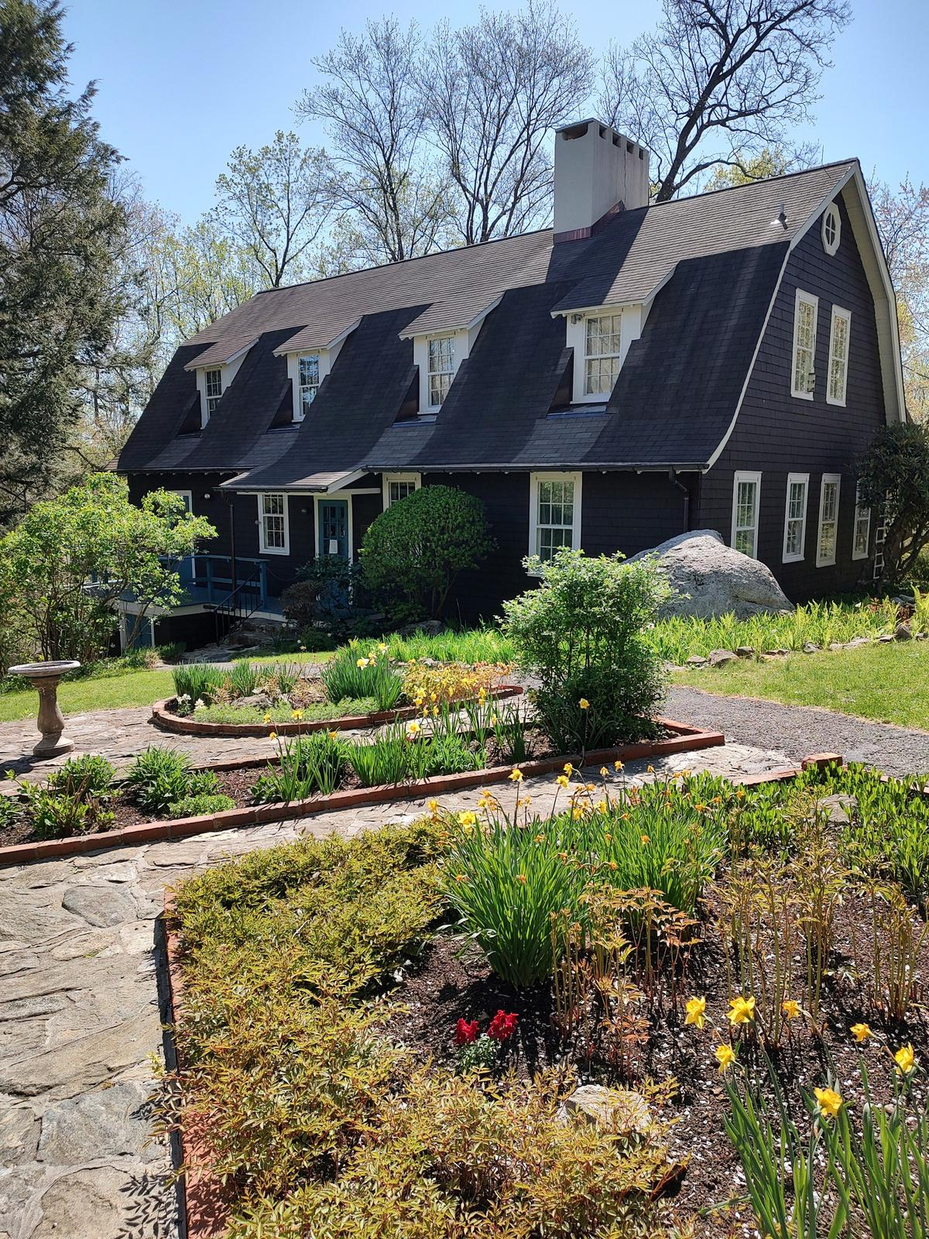
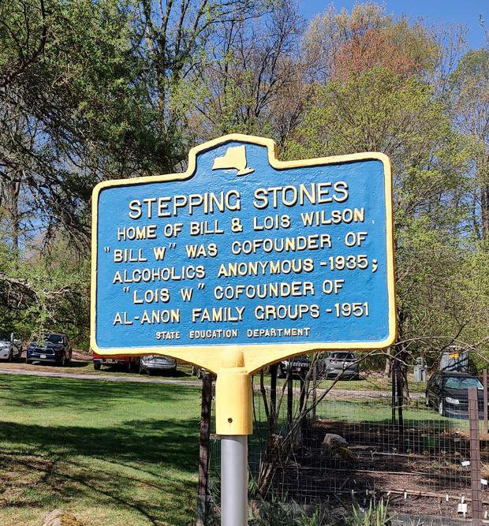
Stepping Stones
Designated a National Historic Monument in 2012
8.17 acres of gardens and grounds
100,000 archival items
10,00 original objects
tours by reservation only
steppingstones.org

Slide 34
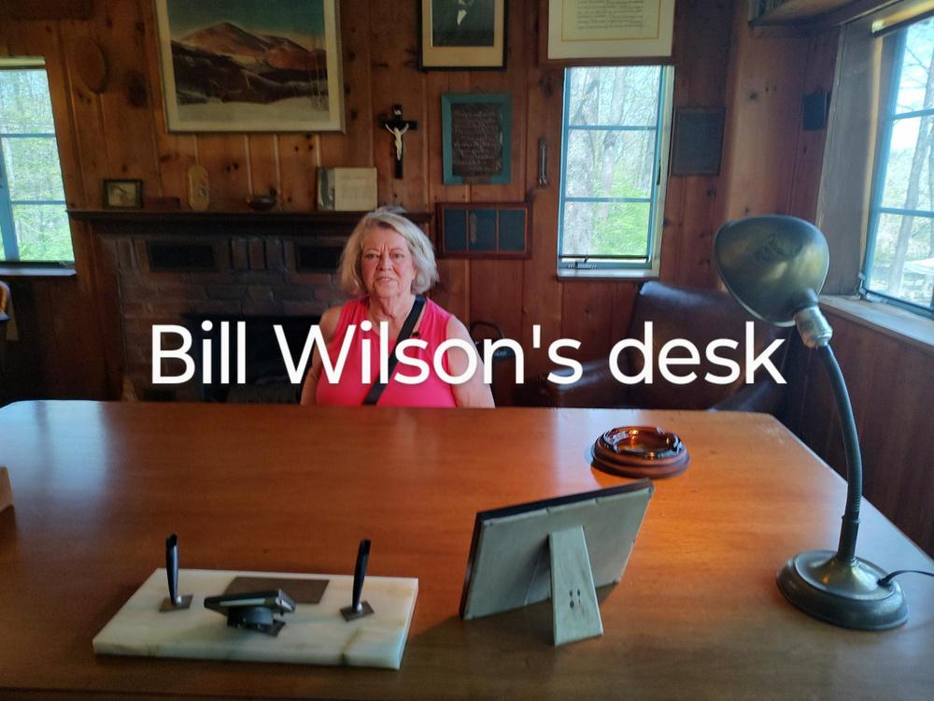
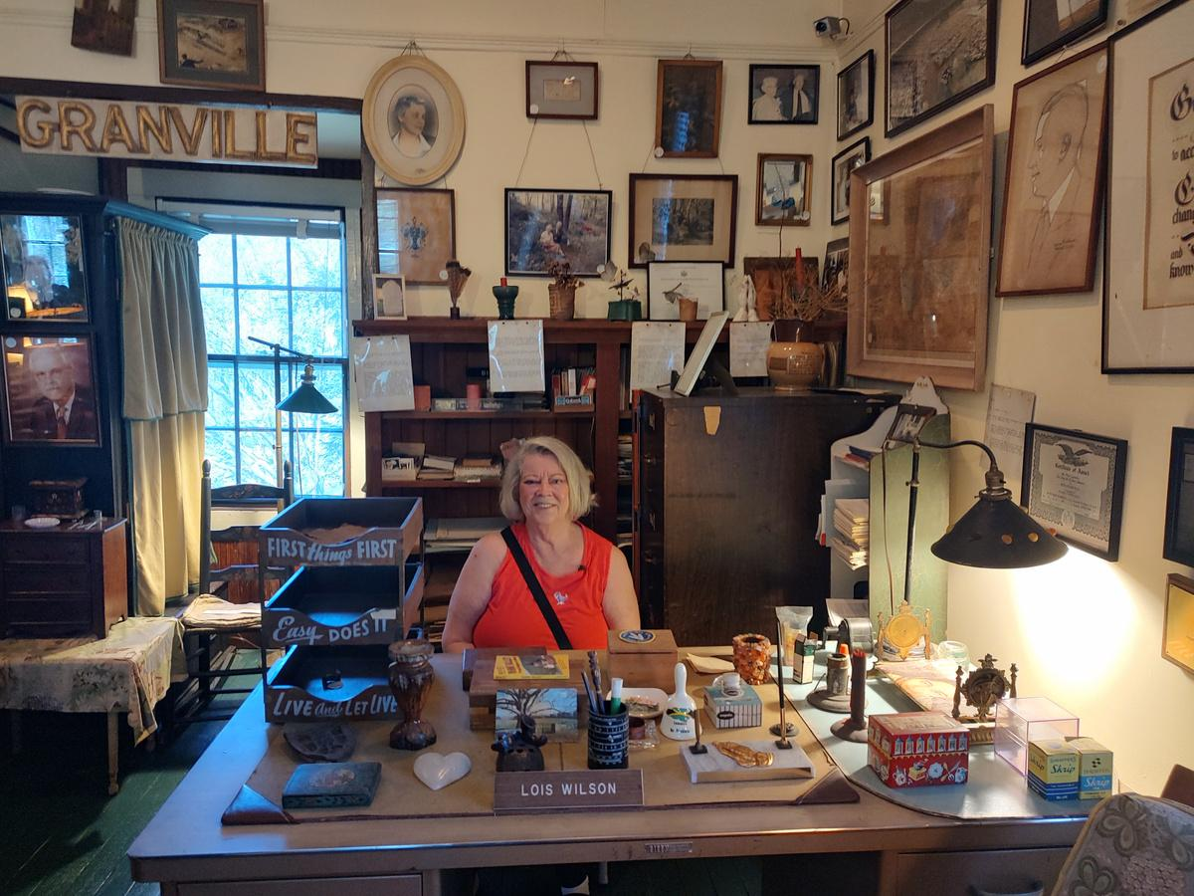
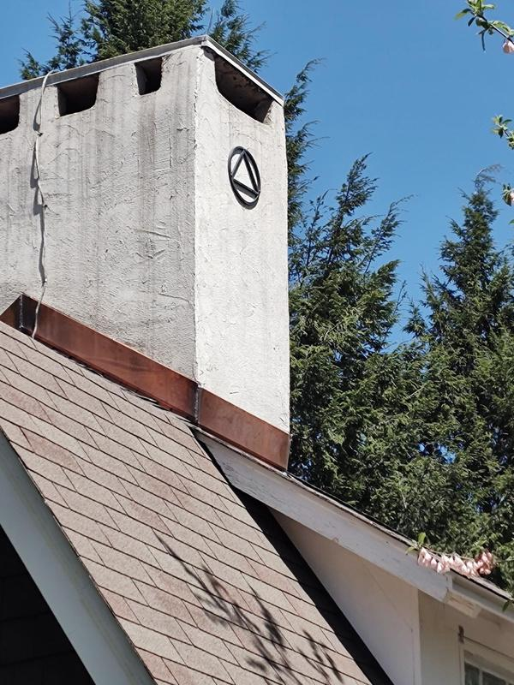
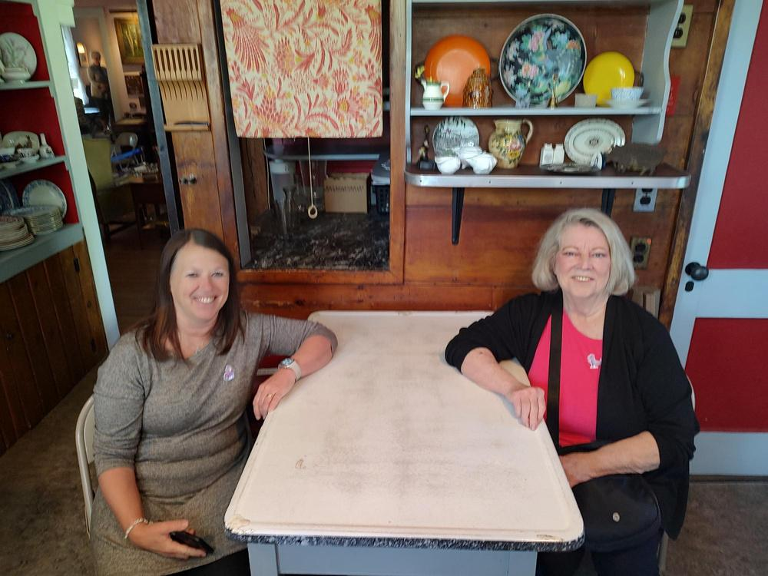
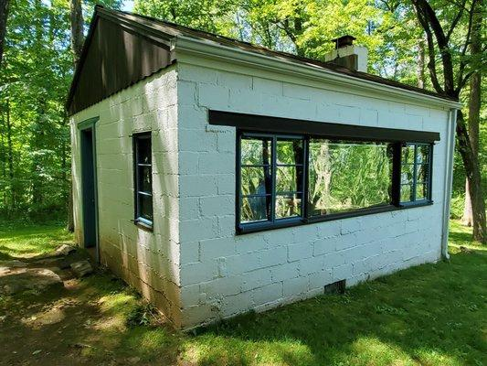
Stepping Stones cont:
Lois’s desk
Lois’s kitchen
table
Wits End

Slide 35

EVENTS
1685 Al-Anons registered to date
45 French
116 Spanish
2 ASL
47 Alateen
C
No CASH, CC only at events
NO organized transportation
get ready to walk!
80,000 expected

Slide 36

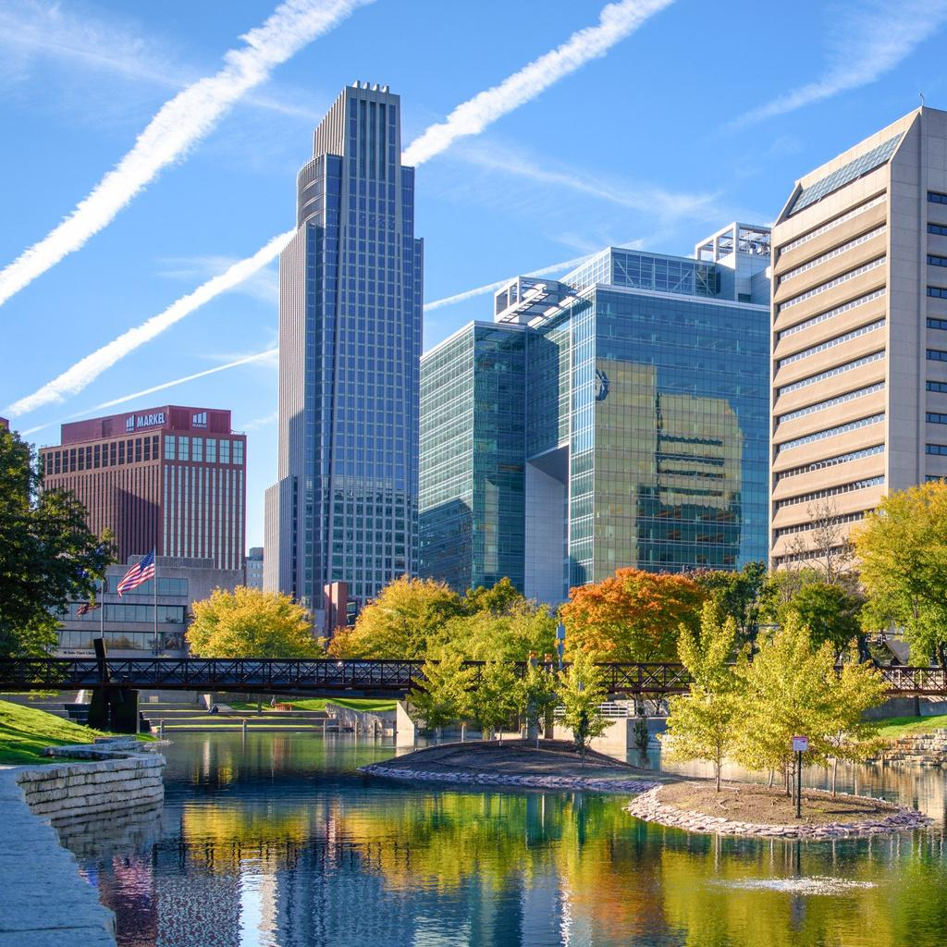

EVENTS cont:
Omaha, Nebraska October 2025

Slide 37
Where will the 2028
International Conference be held?
Guesses???
put in chat

Slide 38

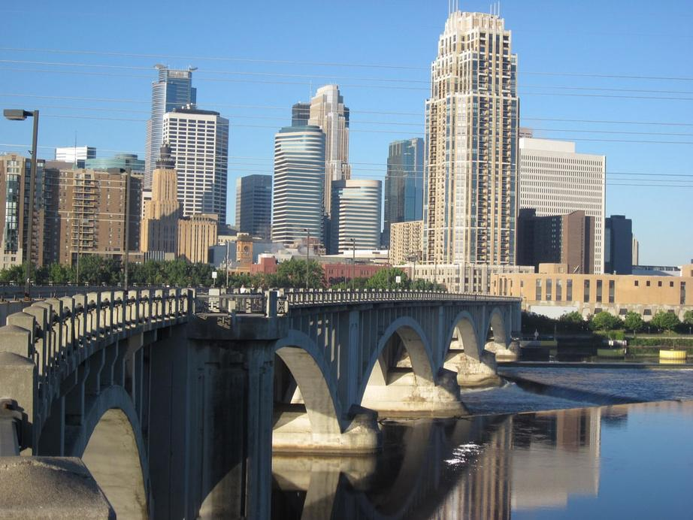
EVENTS
Al-Anon 2028
International Convention
July 20-22, 2028
Minneapolis, MN

Slide 39

This Delegate’s report is available on our Idaho Area 13 website:
https://al-anon-idaho.org
Thank You for listening
END

