Slide 1

Our Path toward Grace, Unity, and Understanding
Notre cheminement vers la grâce, l’unité et la compréhension Nuestro camino hacia la gracia, la unidad y la comprensión
2024 World Service
Conference Report
Cheryl Sorenson - Idaho
Delegate P63
64th Annual
World Service Conference 2024

Slide 2

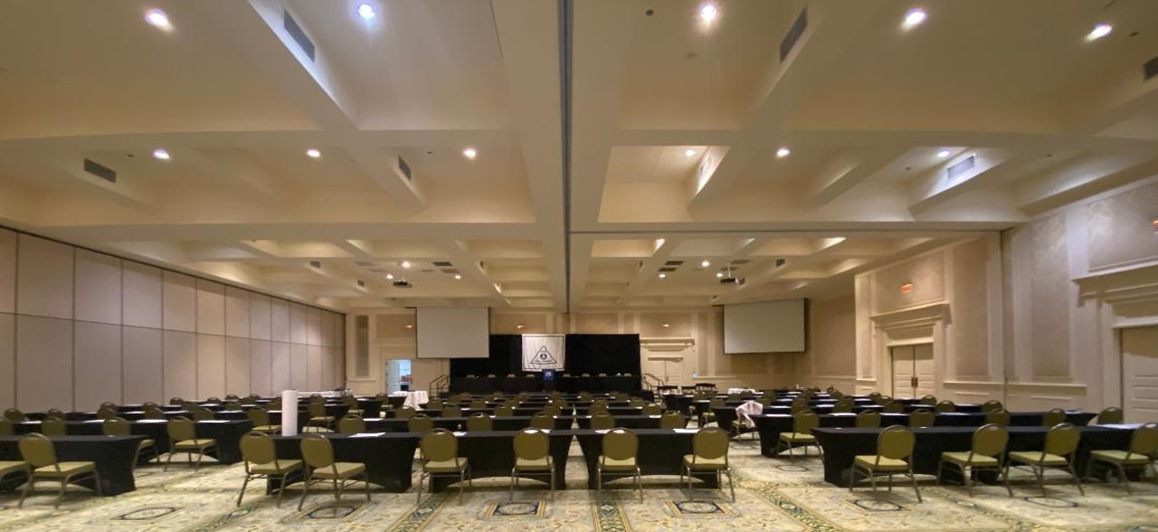
Welcome and Opening
Your paragraph text
P64 - “In Service We Soar”
P63 - “Service is the Key”
P62 - “It Started With a Shoe”

Slide 3


Introductions / Roll Call Voting instructions
WSC Committee
Kathi Maggio - Conference Chairperson
Jamie Crisalfi - Associate Chairperson
Jeri Wesner - Chairman of the Board
Ann Marie Ziffer - Treasurer
Pennie Kittilson - Director of Policy
David Bruce - Chairman of Executive Committee
19 Trustees
68 Delegates
WSO Staff
Translators
IT Personnel
Tapers
WSO Volunteers
Who’s Who?
WSO Staff
Vali Fayen - Executive Director
Niketa Williams - Director of Finance
Sarah Smith - Director of Programs
Scot Powers - Director of Communications
Heather Smith - Community Relations
Sue Perez - Director Conference
Carol Cowan - Director Literature
Silvia Cominski - Events
Sue Caldwell - ECRPM

Slide 4






Conference Etiquette
*Starting and stopping on time shows integrity
*Stick to the agenda
*2 mins. at the microphone
*Stay on Topic
*No applause
*Cell phones off

Slide 5




Confernce Etiquette Cont.
*No perfumes or flowers
*If you’re unable to attend tell
someone!
*Practice spiritual principles and goodwill

Slide 6


Literature Committee
Discussion
Developing a piece of literature about our relationship with finances in Al-Anon Recovery
Key elements to consider are:
  Al-Anon literature states that the disease of alcoholism impacts us physically, emotionally, spiritually, and financially
  While the topics of personal and group finances are discussed throughout Al-Anon’s three legacies, Al-Anon does not have a single piece of CAL exploring our relationship with finances in recovery
  Financial responsibility is often not taught in alcoholic homes, but can be learned.
This is a work in progress

Slide 7
Literature Update
• We have new piece of Literature that is near completion!!!
• Healing in our Alcoholic Relationships:
a collection of insights from our collective journey
• 48-page booklet and will sell for $4.00
• Will be released this fall: no date yet.
ALSO
• Sharings are now being accepted for the new book on Sponsorship; Personal and Service.
Send in sharings to: https://Al-Anon.org/sharing

Slide 8

Choosing a Group Name
See Svc. Manual Pages 85-86
Tradition 5: We have but one purpose; to help families of alcoholics
*A group’s name will be the 1st impression and should be inviting to all
*Should not imply affiliation with any other 12 step program, church, commercial entity
*Should not have Al-Anon in the title, only AFG
*We want to insure clarity and inclusion

Slide 9



Choosing a Group name cont.
Names can be Confusing:
Make sure the focus is not too narrow
ie: 4th street Al-Anon
No “specialty” names: ie: Marching Band for Al-Anon
Even names like “Men‘s stag, Serenity sisters are deceiving.
WSO denied: “Hope and Serenity for Siblings of Alcoholics“
Focus on similarities
and remember:
ANY Al-Anon member is welcome at ANY Al-Anon meeting

Slide 10
Change your group name if it no longer is relevant!
New Al‑Anon Group Registration Form
For Groups with a Physical Meeting Location
Please submit this form through your Area New Group Registration Process or to the WSO. The WSO will register any group designating itself as an Al‑Anon Family Group with the understanding that it will abide by the Traditions and that meetings will be open to any Al‑Anon members. (Digest of Al‑Anon and Alateen Policies)
1.GROUP RECORD:
2.STATUS: o o
3.GROUP/REGISTRATION OVERVIEW:
ADDITIONAL MEETING: Day _______Time _______ o AM o PM
oFamilies and Friends only o Families, Friends and Observers welcome Meeting Language ____________________Member Count ________
District Number ________________________
Area Name or Abbreviation __________________________________
New Not Sure If Registered
These options have changed. Please see Instructions for updated definitions.
Group names are visible to members, newcomers, professionals, and the public. They are the first chance a group has to offer help and hope. They reflect Al‑Anon principles and are inviting to all. The WSO reviews all proposed group names and reserves the right to delay registration when meeting names are not in keeping with Al‑Anon spiritual principles. Contact your Area Group Records Coordinator or the WSO for further information.
oIntroductoryoLimited AccessoFragrance Free oHandicap AccessoChild CareoSign Language oSmoking PermittedoBeginners
Location Instructions _______________________________________
________________________________________________________
Group Name _____________________________________________ MAILING LANGUAGE: o English o French o Spanish
LOCATION:
Meeting Place ____________________________________________
Meeting Address __________________________________________
City ________________________________State/Province ________
Zip/Postal Code _______________________Country _____________
Group Email ______________________________________________
PARTICIPANTS:
5.CURRENT MAILING ADDRESS:
(WSO mail for the group is sent to the postal and email addresses)
First Name __________________Last Name ___________________ Street/PO Box ____________________________________________ City________________________State/Province ________________ Zip/Postal Code ______________Country ______________________ Phone Number_______________CMA Email ___________________
This information is optional. In keeping with Traditions Three and Five, our groups welcome anyone affected by someone else’s drinking. Every Al‑Anon meeting is open to every Al‑Anon member.
6.GROUP REPRESENTATIVE (GR) (if available):
Members of Al‑Anon who are also members of A.A. do not serve as Group Representatives. “Members honor this policy out of respect for Al‑Anon unity and the group conscience
process, in accordance with Tradition One and Tradition Two.” (Digest of Al‑Anon and Alateen Policies)
oParents of Alcoholics o Adult Children o Women o LGBTQIA+ oPeople of ColoroYoung AdultsoMen
PHONE CONTACTS FOR THE PUBLIC:
First Name 1 __________________Phone Number 1 _______________
First Name __________________Last Name ___________________
Street/PO Box ____________________________________________
City _______________________State/Province ________________
Zip/Postal Code ______________Country ______________________
First Name 2 __________________Phone Number 2 _______________Phone Number_______________GR Email _____________________
4.MEETING DETAILS: Day ________Time _______ o AM o PM
oFamilies and Friends only o Families, Friends and Observers welcome
Meeting Language ____________________Member Count ________
Check the boxes to narrow meeting descriptions
By registering as an Al‑Anon Family Group with Al‑Anon Family Group Headquarters, Inc. (AFG, Inc.), a group is granted permission to use the Al‑Anon trademarked name and logo without modification for the purposes of Public Outreach as well as AFG, Inc. copyrighted materials for the sole purpose of conducting its meetings. Al‑Anon copyrighted materials are limited to:
•Suggested Welcome, Suggested Closing, Suggested Preambles to the Twelve Steps, the Twelve
Steps, Twelve Traditions, and Twelve Concepts of Service as they are found in the current version
of the Al‑Anon/Alateen Service Manual (P‑24/27), without alteration or modification.
•Conference Approved Literature (CAL) screenshots or printouts, when accompanied by copyright
acknowledgment and limited in scope to content possible to be shared and discussed during one
meeting.
This permission is granted for as long as the group continues to hold meetings; remains in
compliance with AFG, Inc. intellectual property policies and instructions; refrains from distributing
or posting permanently, in a public forum, copyrighted materials; and remains an Active registered
group with AFG, Inc. These materials may not be modified and permission to use these materials
may not be transferred to anyone without prior written approval. The group shall not use the
materials in any way that could damage the reputation and goodwill that has been established in
the materials.
These options have changed. Please see Instructions for updated definitions.
oIntroductoryoLimited AccessoFragrance Free oHandicap AccessoChild CareoSign Language oSmoking PermittedoBeginners
Location Instructions _______________________________________
________________________________________________________
This can be done online!
Submitted by _________________________Date ________________Phone ____________________Email ___________________________
Al‑Anon Family Groups Headquarters, Inc., 1600 Corporate Landing Parkway, Virginia Beach, VA 23454
phone: (757) 563‑1600 • fax: (757) 563‑1655 • email: AFGRecords@al‑anon.org • website: al‑anon.org
Revised March 2022

Slide 11
Prize slide:
How many Delegates attend the WSC ?

Slide 12

68

Slide 13

Delegate Participation on CLT
Conference Leadership Team
Delegates have expressed concern about their ability to help decide what will be on the agenda
**Delegates are 2/3 of the conference participation, yet often feel that we are being dictated TO instead of advocating FOR
**Delegates want more transparency
**Delegates would like more “Voice” to advocate for their Areas and groups
**put to vote and going forward Delegates will have 3 seats

Slide 14

What we Voted on
2024 Budget
2023 Audit report
Various service manual re-wordings
Annual Report
New Finance piece for CAL
Delegate Participation on CLT
Trustee Seatings
...all were confirmed...
Did you know?
Delegates can use their own authority to vote without an Area group conscience?
pg 228 Svc. Manual

Slide 15

Alateen
A survey was sent out to US, International, WSC and Area Coordinators to see what the feasibility and interest would be to expand an electronic Alateen network
New Terminology
EASM: Global Electronic Alateen Safety Minimums
EASBR: Global Electronic Alateen Safety and Behavioral Requirements

Slide 16

Alateen cont.
Concerns:
** Can international structures meet the strict requirements to local laws or other factors?
**Can the U.S. adhere to the stricter International laws?
**Can Requirements be applied globally?
**The WSC adheres to the global EASM, so....
All areas within the WSC structure that wish to use the Alateen name to host electronic meetings will be required to adhere to the WSC EASBR

Slide 17
Global Electronic Alateen Safety Minimums (Global EASM)
WSC Structure Electronic Alateen Safety &
Behavioral Requirements (WSC EASBR)
The minimum set will adhere to the strictest requirement in the structure on reporting about abuse, self-harm, etc. Structures will adhere to the legal requirements if required to report.
The requirements will ensure teens are in the presence of adults who are safe to be
around based on the available standard the country uses.
Each Alateen group must meet virtually with the teen to allow the teen to validate their
age and provide other registration details.
Each Alateen participant's identity must be verified, and the AMIAS must creat a record of
approved/verified participants.
Group Sponsors/AMIAS must have the help they are seeking should the authorities need to
be contacted.
Only age-appropriate minors can attend the meeting, and Group Sponsors must have data
to inform those who are approaching the age limit and ensure the Alateen members who
are joining are adhering to the structure's policy.
Teens attending the meeting must be known to Group Sponsors and have been verified.
Al-Anon members involved in Alateen service serving Electronic Alateen Groups (AMIAS_E) will be mandated reporters.
AMIAS_E must pass a background check that verifies they have not been convicted of a felony or charged with child abuse or any other inappropriate sexual behavior.
Each Alateen group must conduct a pre-interview of any new teen wighing to attend.
Pre-interview (registration) must be facilitated by registered AMIAS for that specific group.
Teen must show proof of age with photo ID, provide contact info. where they can receive the meeting link, share emergency contact info. of custodial parent or legal guardian before being admitteed to an electronic Alateen meeting.
AMIAS/Group Sponsors maintain a list of information on Alateens interviewed and admitted to that specifice group.
Alateens must show photo ID. Upon each subsequent entry to their electronic Alateen group, which is verified by AMIAS against the group list.

Slide 18





















Global EASM cont
WSC EASBR cont
Group attendees are registered through the defined process, and only registered attendees/AMIAS have access to the meeting link
There must be a method for members to join the meeting without breaking anyone’s anonymity
The safety of both the AMIAS and Alateens must be ensured through appropriate staffing
Electronic Alateen group meeting links are not published on public facing websites
Only group name, meeting day, time and group emails may be displayed. Group email must protect member anonymity
Two sponsors are required for an electronic Alateen group meeting to take place
Who’s ready to get on board
with Alateen and make this happen?

Slide 19
Budget for 2024

Slide 20
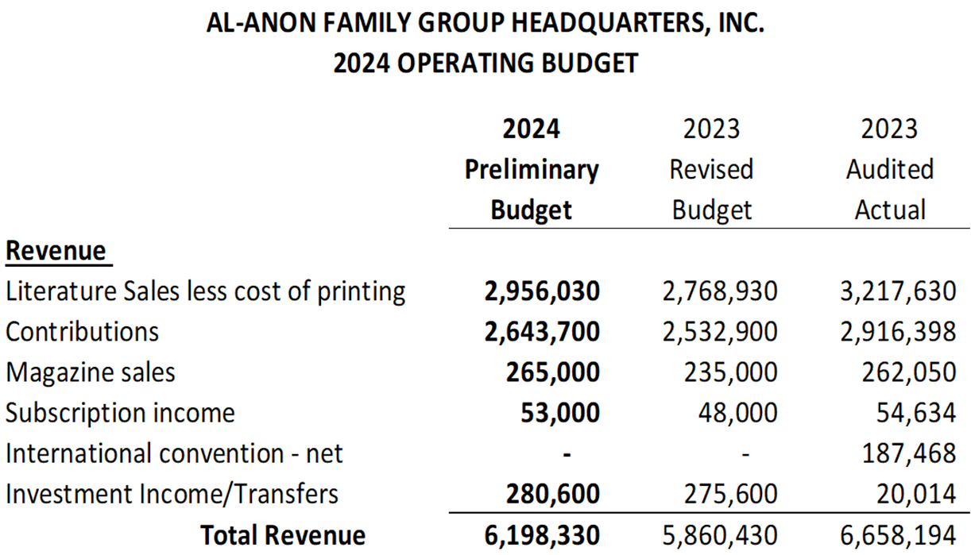
2024 Revenues

Slide 21
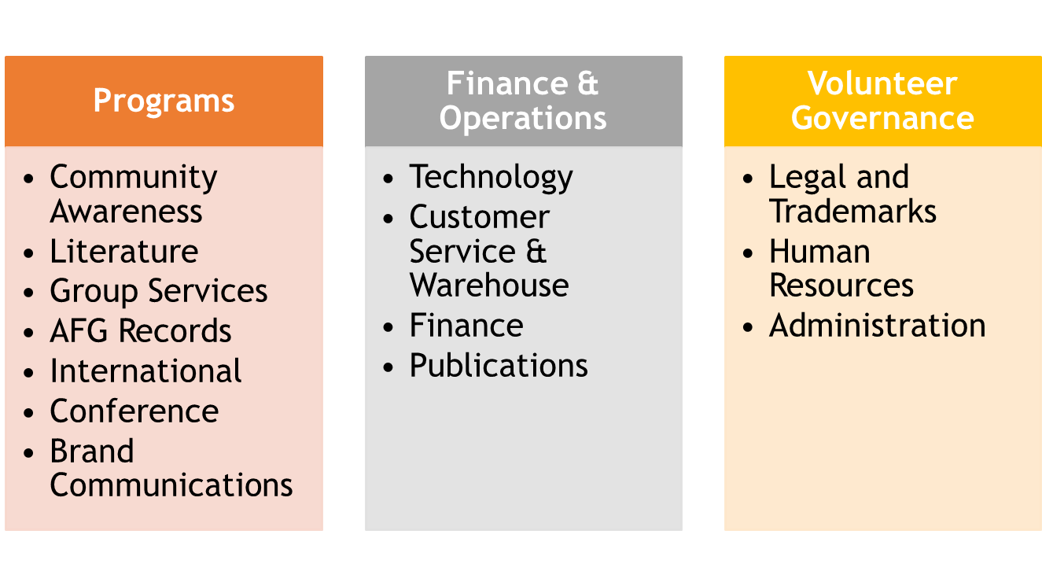
Budget Inputs

Slide 22
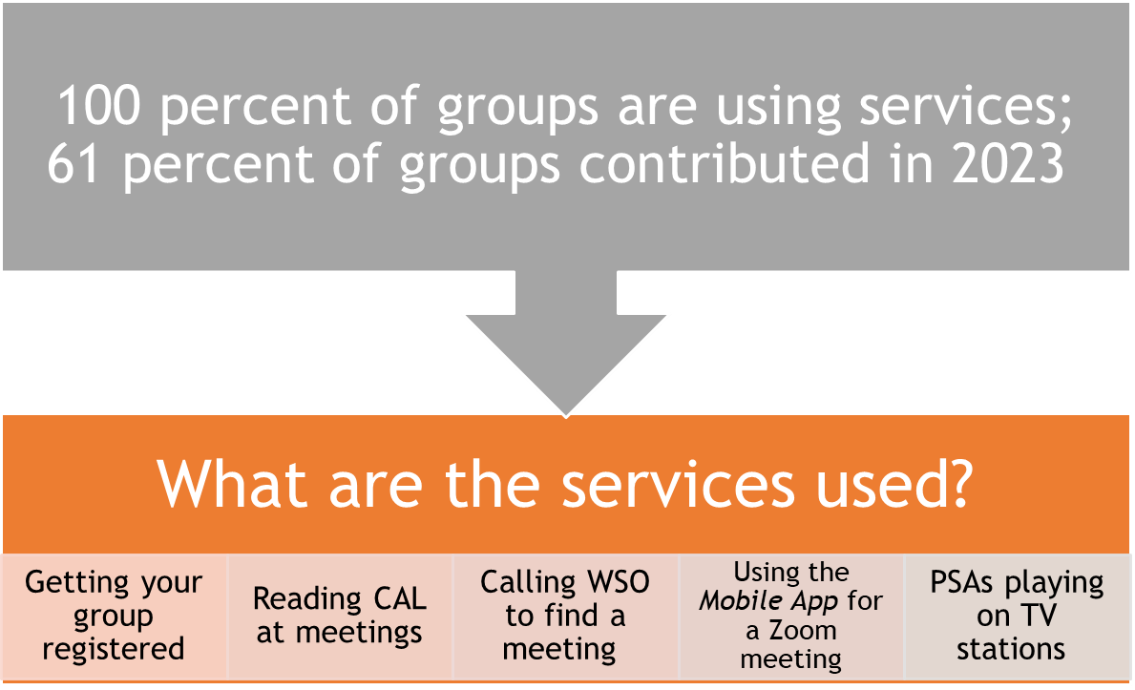

Slide 23

Idaho Group 7th Tradition Contributions to WSO
% of Groups donating Avg. per Group 2023 2022
54% in 2023 $159.20 $6846 $9565
61% in 2022

Slide 24
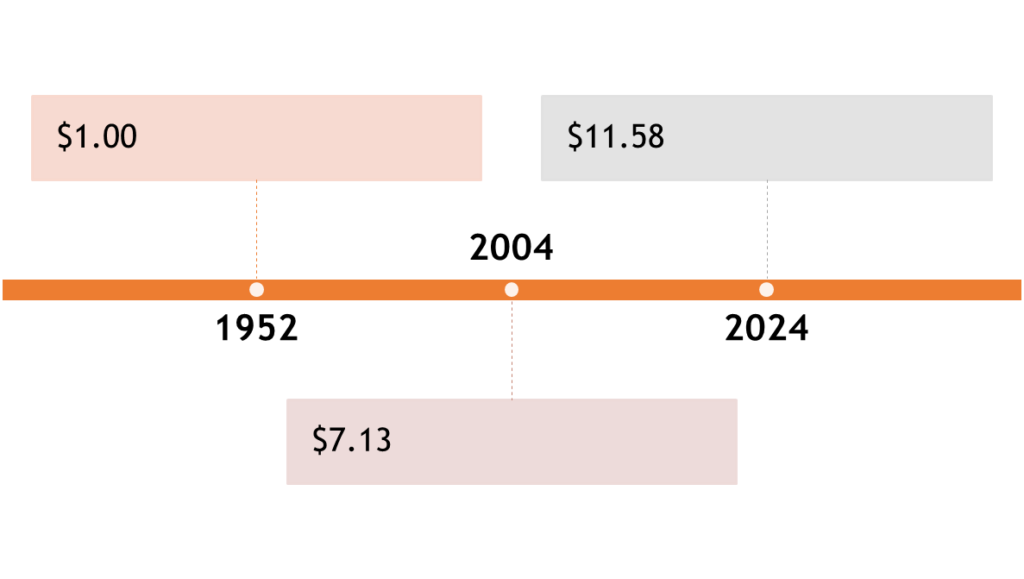
POWER OF
$1

Slide 25
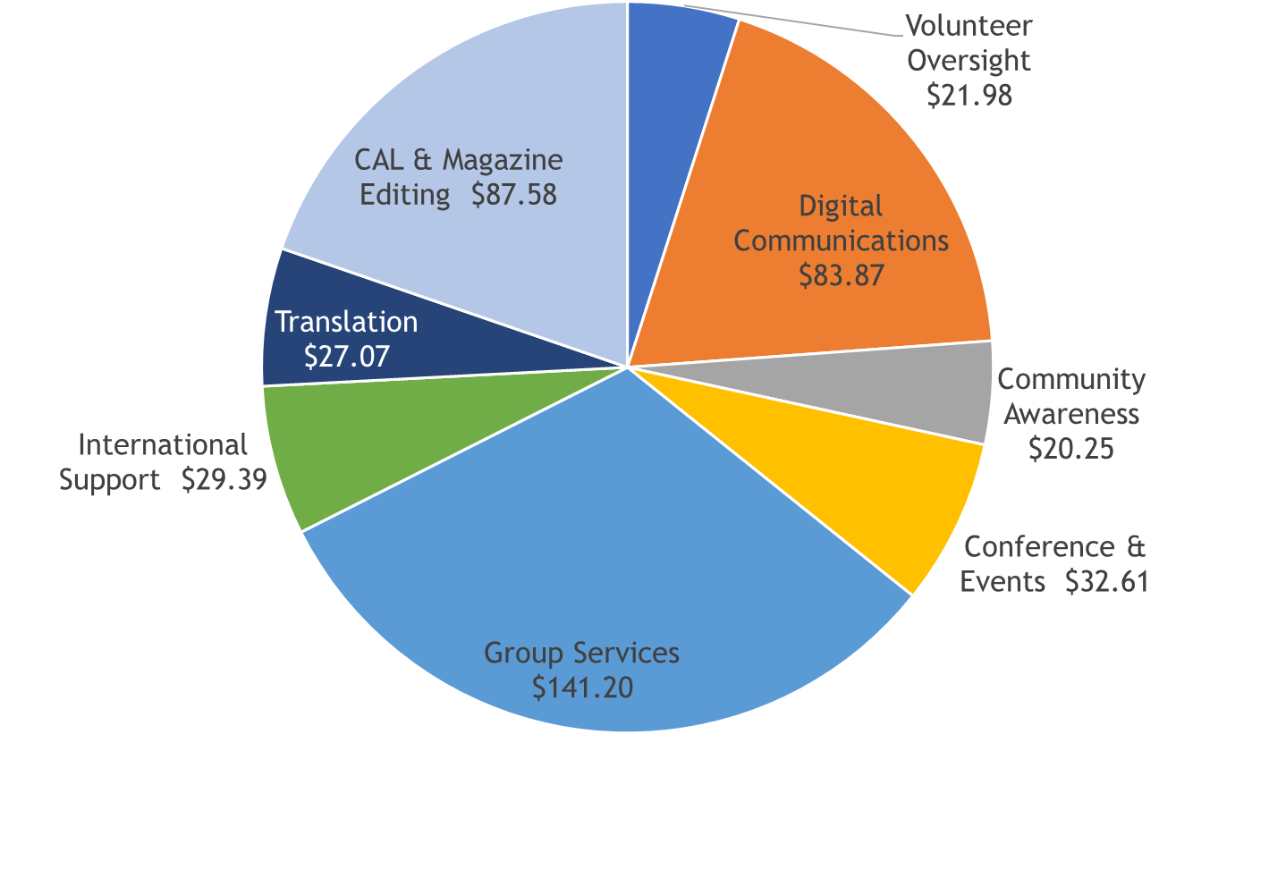
Cost per Group: $330.09

Slide 26

WSO Investment Strategy
Merril Lynch
& Davenport are WSO’s financial advisors
No investments are in alcohol
related companies
Nakita Williams (Director of Finance) is NOT a member of Al-Anon by design
Investment are moderate,
2023 was a favorable year

Slide 27
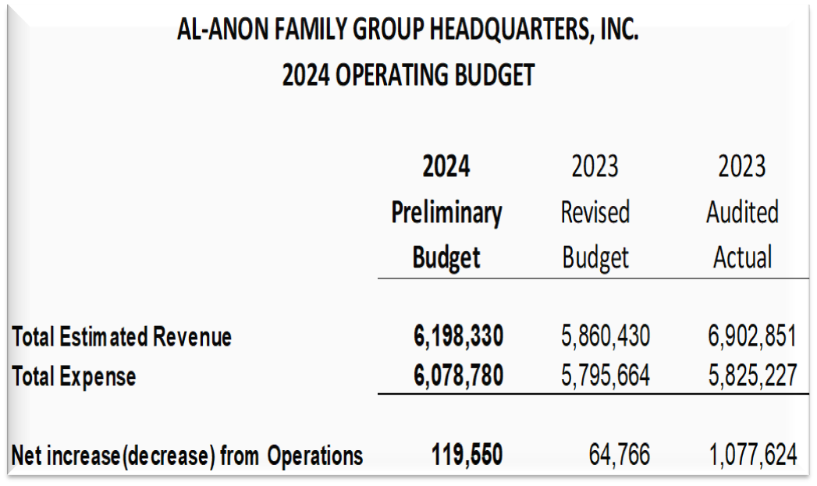
What’s the Bottom Line?
*2024 Operating Budget has a small surplus
*2023 strong performance from book sales does not carry over into 2024
*Consistent steady giving is the message
*Contributions are budgeted to be consistent with the prior year and higher
than historical levels
*Communicate the contribution goal to the fellowship throughout the year

Slide 28
Prize slide
What is the estimated cost that
WSO spends per group?

Slide 29

$330.09

Slide 30

Sponsorship Workshop
Sponsor
Service Sponsor
Sponsee
The Charge:
:
To develop a workshop for use by the Areas, Districts, and groups to increase the awareness and the benefits of sponsorship, both personal and service to all members.
We were to consider the following:
•What is the difference between personal and service sponsorship? Are both needed and why?
•How do we encourage awareness of the two types of sponsorship using current literature.
•How do we find a Sponsor?
•What is the role of a personal Sponsor? What is the role of a Service Sponsor?

Slide 31
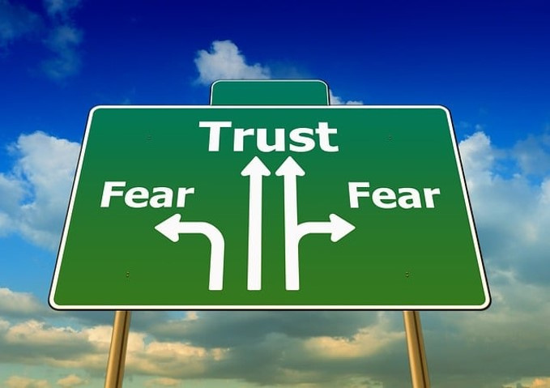
Topics:
1.How to Get and Use a Sponsor
2. How to Navigate the Relationship
3. Challenges of Getting and
Using a Sponsor
4 .Service Sponsorship
5. I want to Be a Personal or Service Sponsor
Skits
Full day, Half Day and 30 min workshops were presented
Full Workshop is available on AFG Connects
or I can e-mail to you

Slide 32
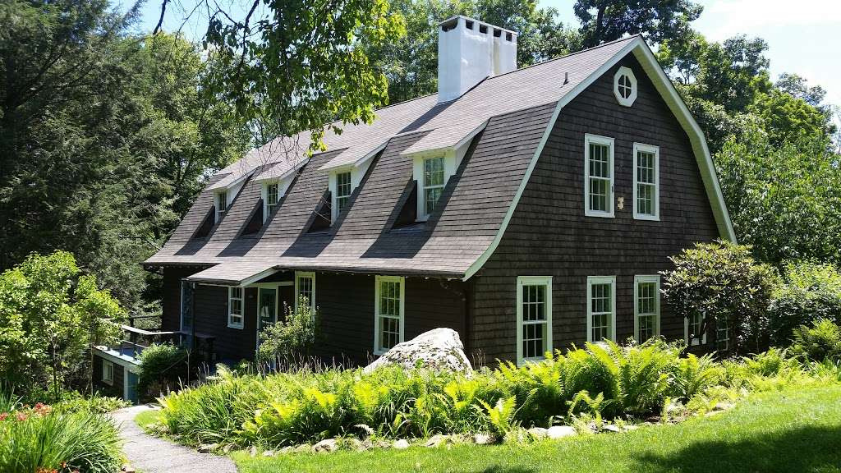
Stepping Stones

Slide 33
Charge:
To hold the the WSC in New York State every 3 years in order to allow Delegetes the opportunity to visit Stepping Stones
Discussion:
*For 64 years the conference has included in their budget and equalized expense an allowance for the Delegate visits.
*Holding the conference in NY state will result in an increase in Conference costs.
*Delegates were asked to contact their Areas for input on the importance of
this spiritual visit.
*A Committee was formed by the Delegates to plan the visit after the 2025 Conference.
*It was decided that the additional cost would be passed on to Areas in their equalized expense.
*A vote was taken and passed that the Spiritual Visit would continue for Delegates.

Slide 34
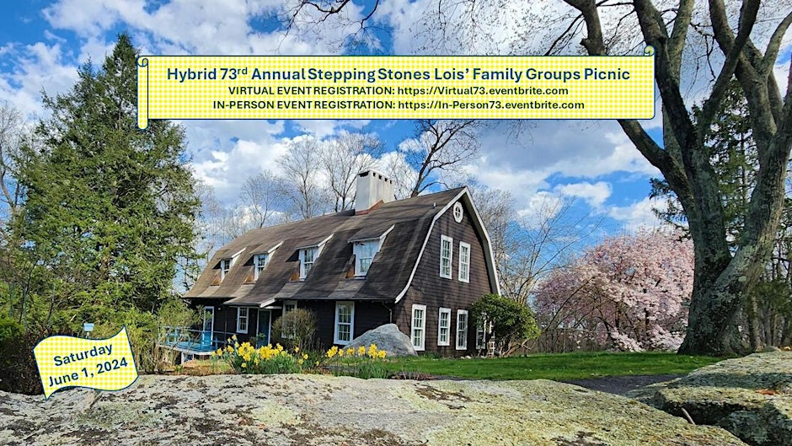
EVENT

Slide 35

AFG RECORDS Next Generation

Slide 36
AFG Records Next Generation
GEMS: Global Electronic Meeting Search
GEMS is focused on inviting members, rather than promoting meetings
GEMS is automatically updated when meetings are changed through the GRC (Group Records Coordinator) or website
Hybrid meetings are now on GEMS
*56 geographic WSC Structure Areas now support electronic groups
*Majority have integrated electronic groups into geographic Districts
*Remaining 11 are in progress developing their Area procedures

Slide 37
AFG Records cont.
If your group is a temporary online meeting and you decide to go PEG
(Permanent Electronic Group), you will need to register with WSO with a new name
*If the group does not choose, they will become an unregistered group
*If a group meets one day in-person and another day virtually,
they must make a choice for one or the other
- doing both is not recognized by WSO/hybrid or become PEG
Target Date: 6 mos. to 1 year after notifying WSO
that the Area is accepting PEGs,
temporary electronic groups need to decide to go back to in-person

Slide 38
Gender
LANGUAGE
Discussion

Slide 39
Is the gendered language in the Steps and Traditions in Alignment with Al-Anon’s legacies?
Discussion highlights:
It was discussed that “God” and “Higher Power” should have no
gendered pronouns
In Many Voices, One Journey it states that if we start changing words
in our readings that it may dilute the program
We come to Al-Anon to change, not to change Al-Anon
Changing the pronouns could translate differently in other languages
Al-Anon World Service Charter states:
“No changes are to be made in the Al-Anon or Alateen Traditions, Steps, Concepts or Warranties without written consent of three-quarters of the Al-Anon Family Groups.”

Slide 40

Inclusion
Al-Anon is a unique fellowship that unites members and different backgrounds in an inspiring endeavor Svc. Man. pg 8
We are all equal.
Do we project that?
Does your meeting have greeters?
Is you meeting name all inclusive?
Do you have a newcomer meetng, readings, welcome packets?
Does your meeting have a phone list?

Slide 41
Prize slide
What does the acronym “GEMS” mean in regards to AFG Record keeping?

Slide 42
Global Electronic Meeting Search

Slide 43
Bits and Pieces
WSO Needs You:
Can you speak, read and translate another language? Contact Sue Perez at WSO (this can be a remote position)
Did you know? Al-Anon has a YouTube profile, is on Instagram, Twitter (X), and LinkedIn for professionals?
Want a job at WSO?
Positions are open now, many are remote. Check “In the Loop“ and AFG Connects for current postings

Slide 44

Are you interested in corresponding with
incarcerated individuals about Al-An﻿on?
The Inmate Correspondence Service (ICS) links incarcerated Al-Anon members with members who attend Al-Anon meetings regularly. Members share their ESH and how they apply the Al-Anon principles in their daily lives.
Males are assigned to males, females to females
Inmates and members send letters through WSO
Contacts do not reveal their full names or addresses. Anonymity is protected at all times
For further information: wso@al-anon.org (ATTN: ICS)

Slide 45
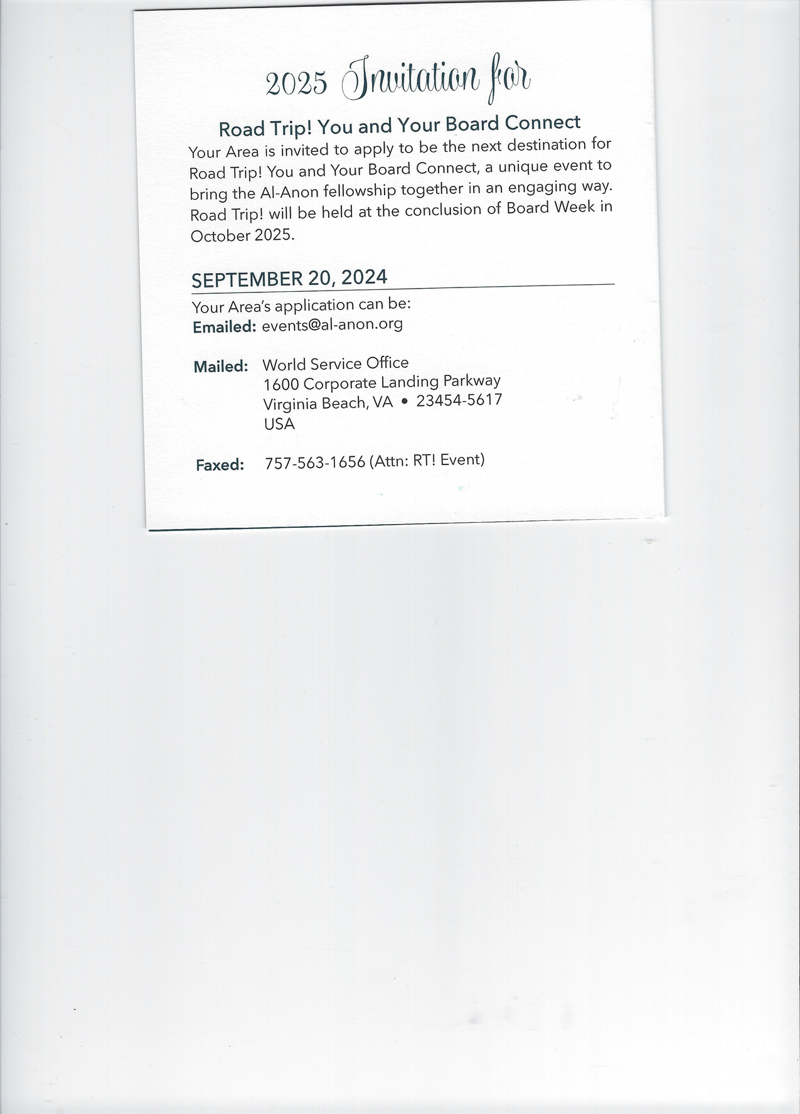
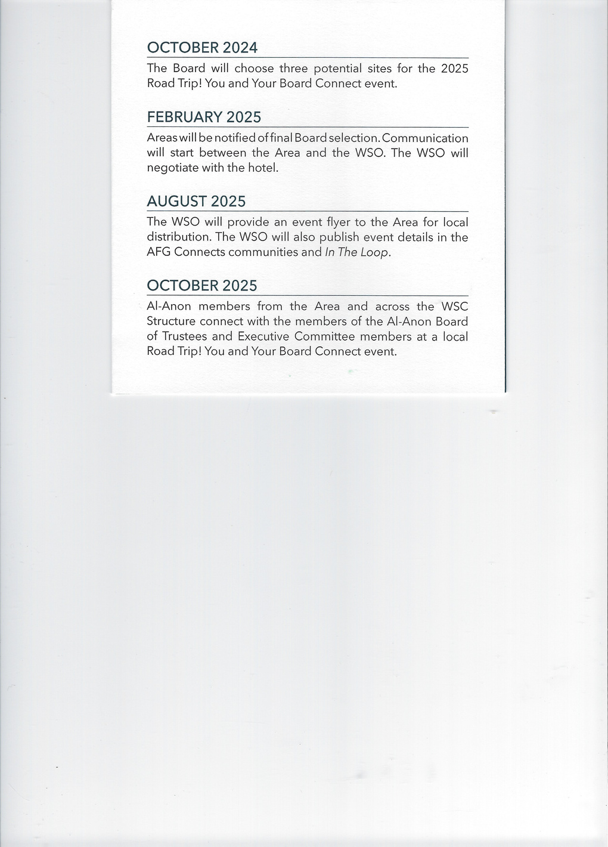

Events
1.
2024 Road Trip is in Columbia S.C.
2.
AA International Convention - 90 Years
Language of the Heart
Vancouver, B.C July 3-6, 2025
60,000 expected attendees

Slide 46
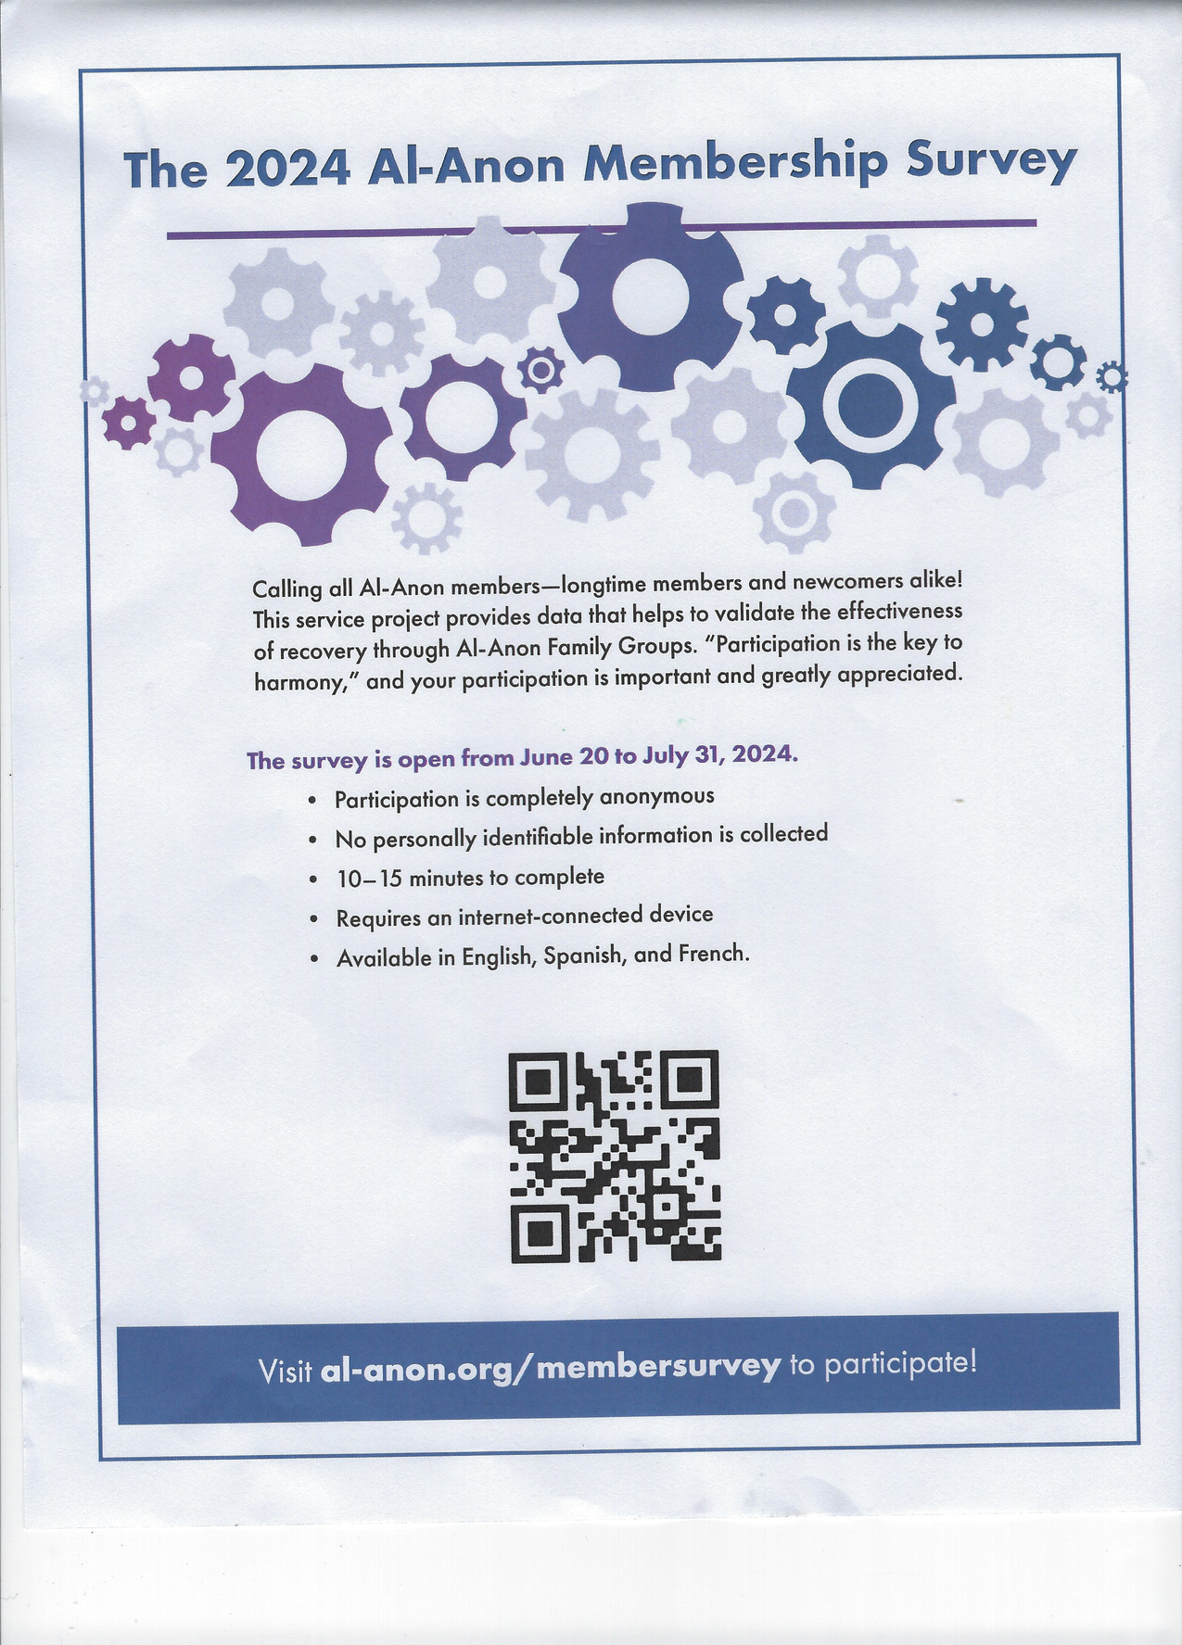
Events cont.

Slide 47

The End

